Slide 1
Eress Forum 2019
More
Energy Collaboration

Slide 2
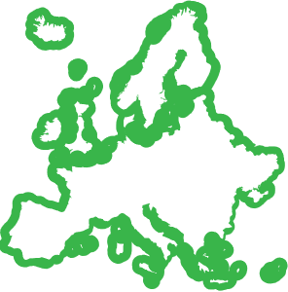
Today’s Situation: Railway Trends
Variation between countries
Traditional measuring
Inaccurate energy billing
Waste of energy
Onboard saving measures
Notes:
The way the railway energy industry is regulated in many countries varies significantly
How can railways work together and compete in the future against other transport modes?
Why even with EU regulation enforcement are national railways reluctant to work together?
They see their neighbour infrastructure managers as their competitors.
They still don’t understand that they need to work together in order to be competitive and attractive enough to survive.
Otherwise, railways will become a dying dinosaur
The average energy consumption of a train is measured per ton and kilometre.
Why do countries not more rapidly install meters on trains? (because of costs. Train operators won’t pay for them, neither infrastructure managers. Train operators see it as an additional cost with unclear benefits)
Various traditional systems lack accuracy and do not reflect the actual consumption.
The variation between estimated and metered energy data, can result in an invoice up to 45% more costly for the train operator.
In the end it is always the train operator who pays for the energy invoice (low or high).
Driving style determines amount of wasted energy.
Energy is also wasted while trains are parked or on service, when the heating/cooling systems on-board are used much more than needed.
Energy saving measures onboard trains are not reflected in the train operator’s bill, when there are no meters.
Without meters (it means just by estimation) it is impossible to see the results of energy saving initiatives.

Slide 3
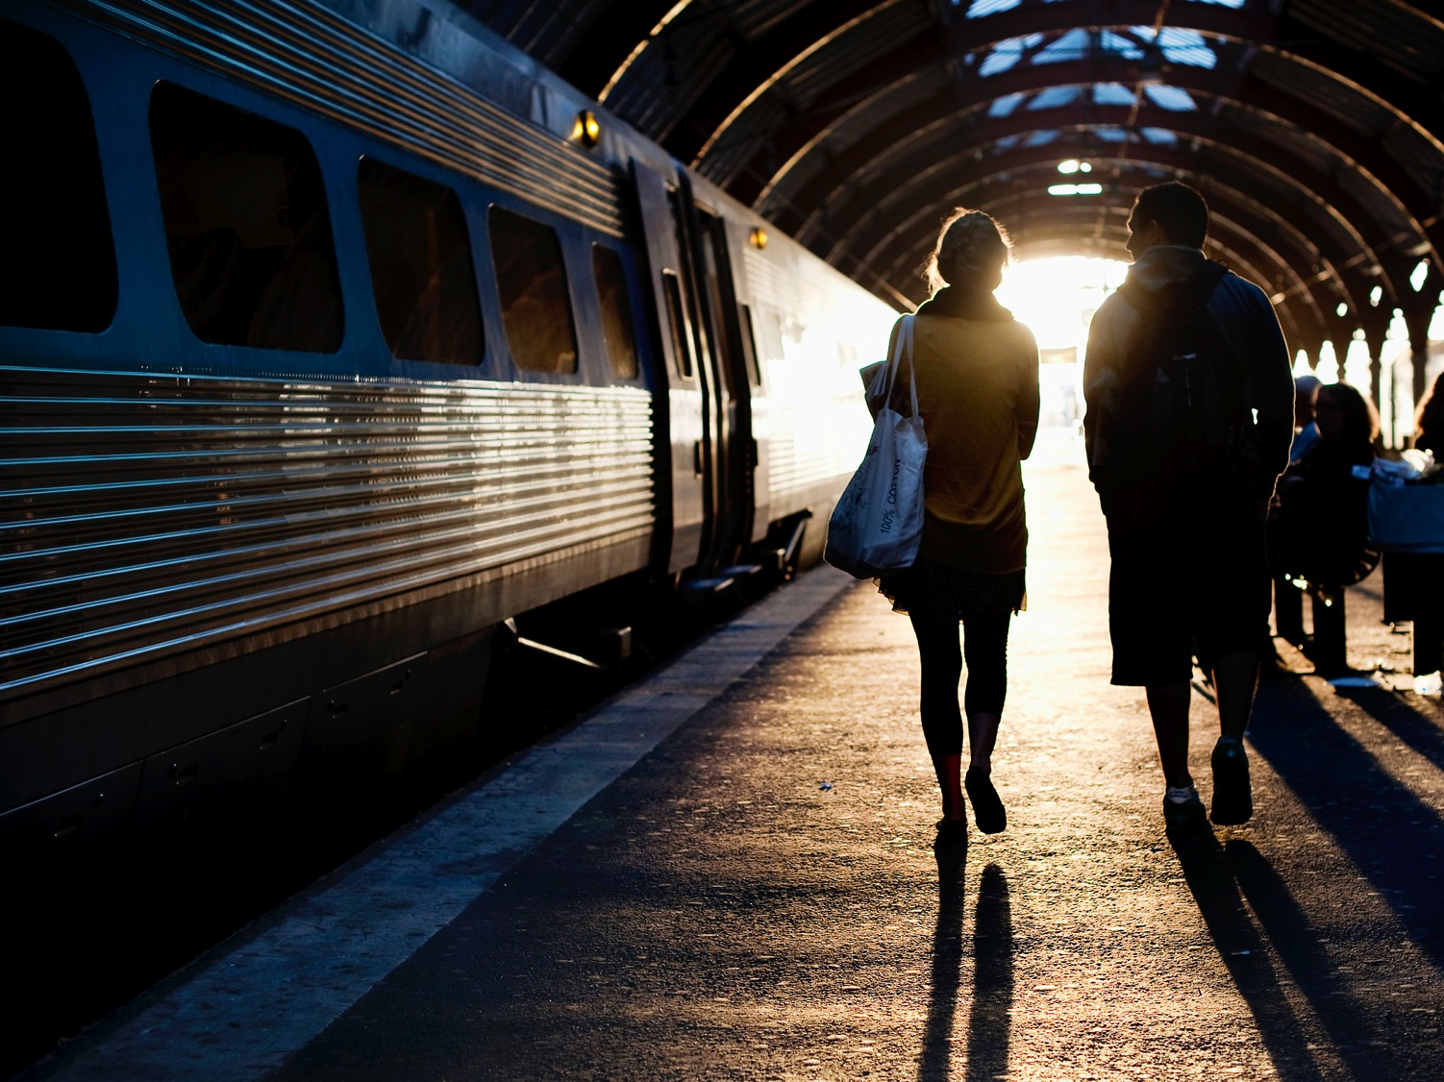
Why is more collaboration needed?
Notes:
Collaboration is needed for the sector to compete and survive,
– the sector will lose to competing transportation alternatives.
Collaboration has been difficult in all railway fields.
How can we work better?
For IMs and TOs: Energy saving is our common goal, what do you do to save it?

Slide 4
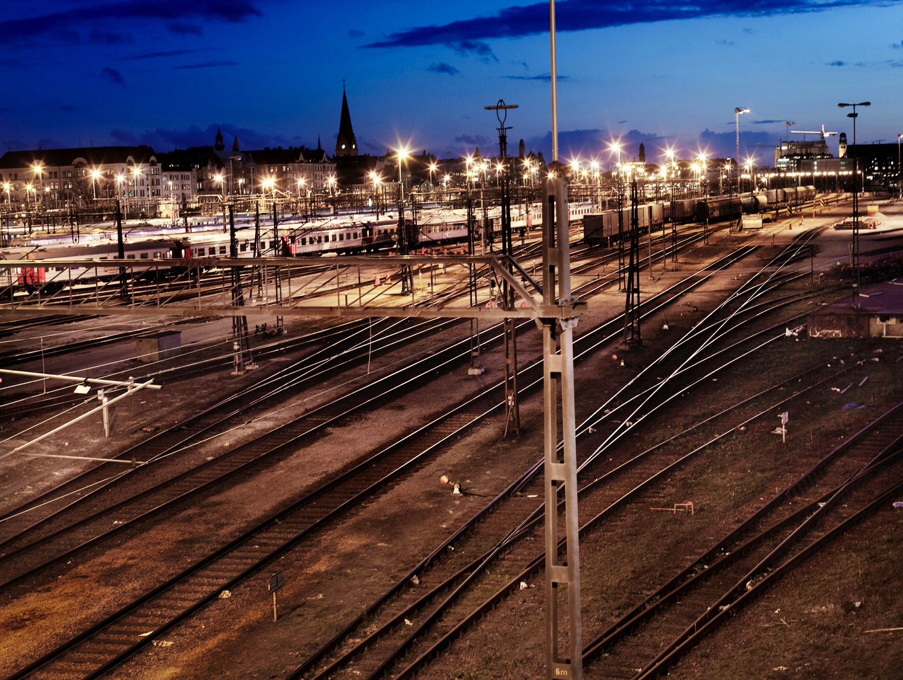
The Solution
Eress
Reduced emissions
Correct billing
Swift implementation
No learning curve
Good economics
Notes:
The leading non-profit organisation in the area of railway energy settlement and billing in Europe.
30 % energy saving potential for trains using Erex.
Erex ensures that train operators pay only for the energy they use.
Able to quickly introduce an industry-proven and operational system.
New Eress members benefit form from the organisation’s experience.
Erex system is not simply a well working system.
The 2019 investment per partner in Eress organization is of EUR 180 000. What can an Infrastructure Manager get for this amount?
The fact that Eress does not need to make money with its settlement system is a great advantage.
Another one is that there is no payback time for the investment, depreciation/amortization and profit margins do not apply.
Eress has a street length advantage compared to any other existing solution, both commercial and non-commercial.

Slide 5
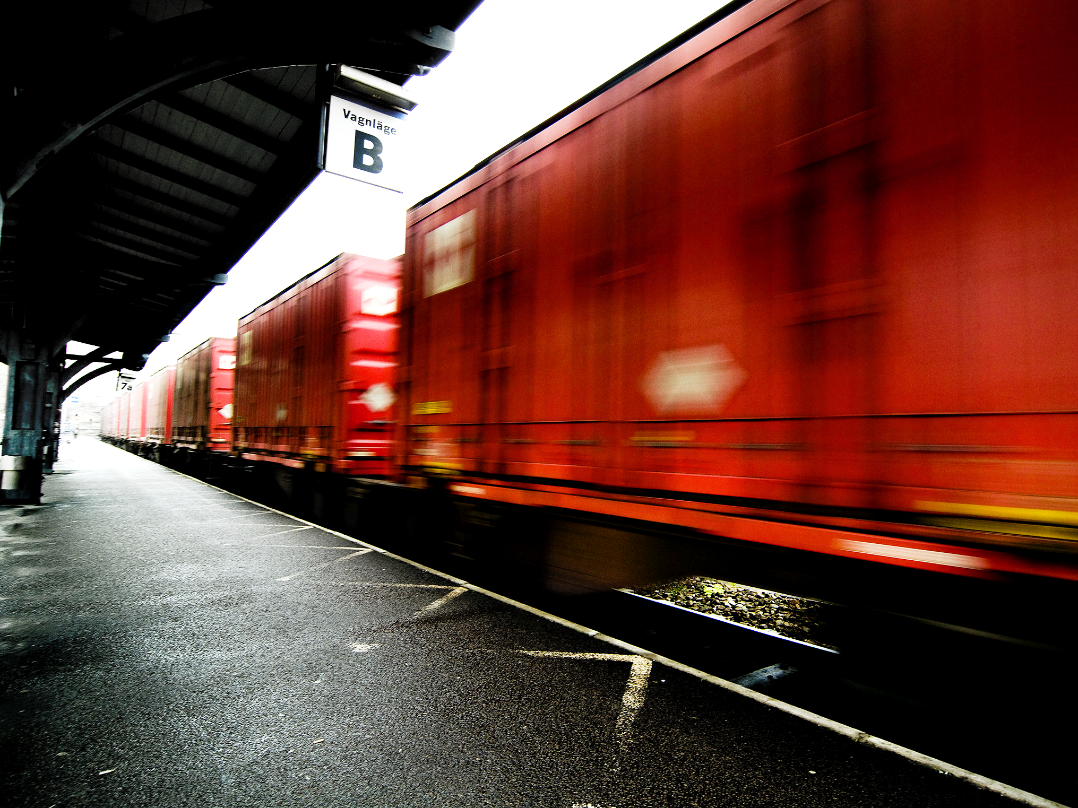
Why Erex: Train Operators
Only pay for what you use
30 % energy savings
Smart driving
Increased competitiveness
Total control
Green good-will
Notes:
Erex settles the trains’ actual energy consumption and bills the actual energy cost.
Erex enables smart driving, which gives an immediate saving in less energy costs.
Erex gives you total control of the train’s actual energy consumption.
Measured journeys have shown savings up to 30 %.
Higher profitability + more financial flexibility = Increased competitiveness.
Climate friendly and innovative initiatives creates public and business good-will.

Slide 6
Finland: Regenerated energy June 2018 - April 2019
Notes:
Metered passenger trains
Highlighted: most regenerated energy in June & less regenerated in December
Erex sheds light on the energy actually consumed or regenerated

Slide 7
Norway: Regenerated energy 2007-2018
Notes:
Train companies shall pay for energy based on real consumption and market price. Not based in estimated figures like ton km or gross ton km. The infrastructure manager shall ensure that the train companies have the possibility to become more competitive and take advantage of their energy efficiency and saving projects.
As an example I would like to present how we treat regenerative breaking in Norway.
All regenerative breaking is bought from the train companies at marked prices. 100%. Its defined in our settlement rules – both for measured unites and unmeasured units (separate factors for estimating both delivered and regenerated energy when train companies apply gross ton km for calculating energy consumption.) The amount of regenerated energy is shown on the invoice.
Erex functions as a clearing system for the energy produced by the trains. Erex ensures that all regenerated braking energy produced finds a buyer.
The amount of regenerative breaking energy has increased with 164% since 2007. From 48.000 MWh to 128.000 MWh.
18,6% of all energy delivered to the traction units are regenerated and fed back to the overhead contact line system. 10 years a ago the figure was 9%.

Slide 8
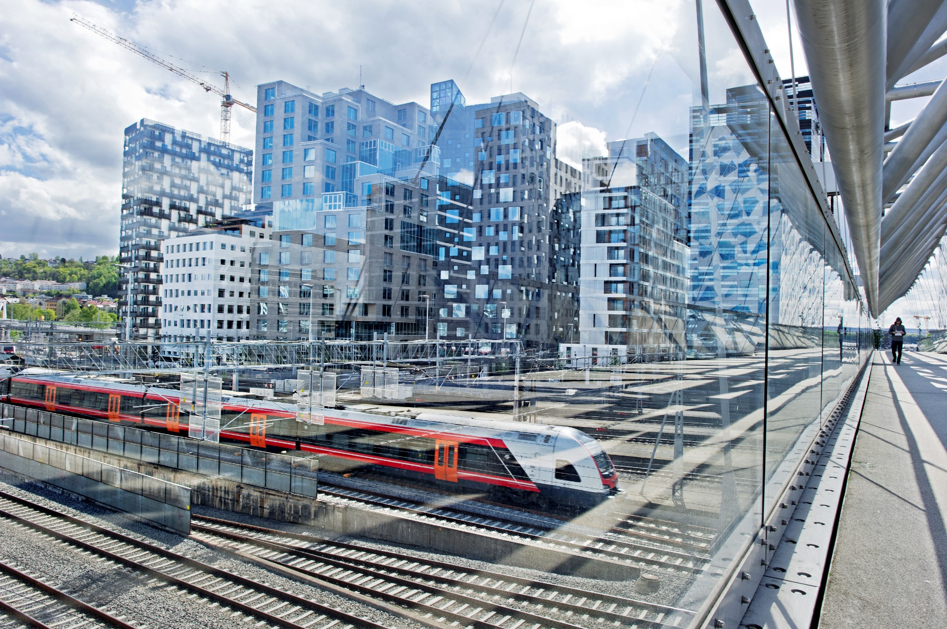
The new Flirt regenerates, on average, 27%
of the energy delivered
Notes:
The new Flirt units. They return 27% of all energy delivered. Best in class is the Flirt sets run by Vy on Gjøvikbanen. On average they feed back 36% of all energy delivered.

Slide 9
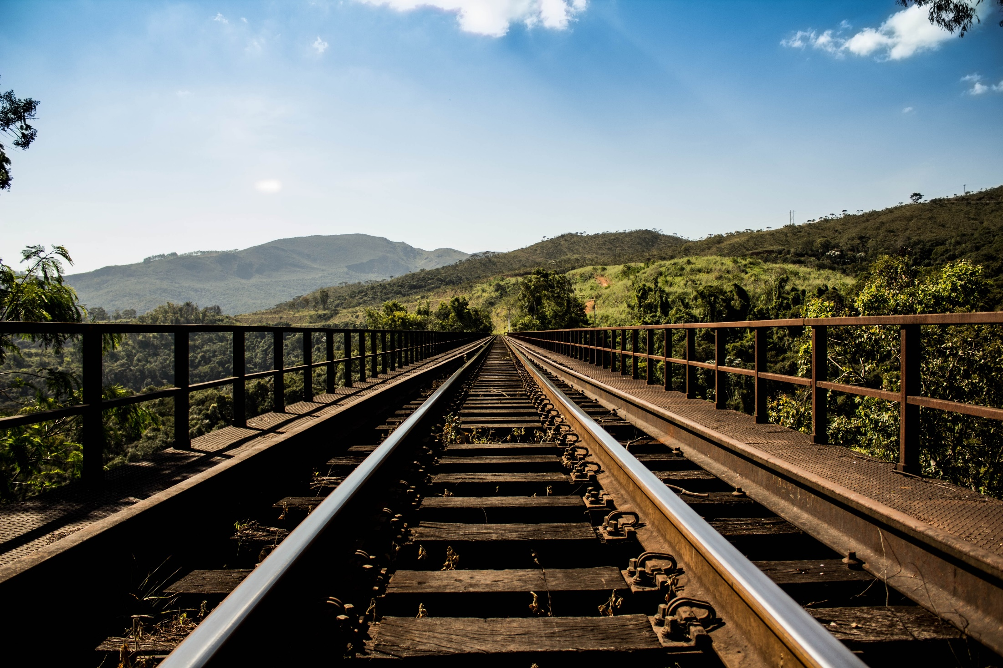
The Netherlands
EUR 5 mill
EUR 1,5
Estimated price development
Estimated annual cost, system maintenance
Notes:
Why did The Netherlands chose Eress?
In 2012 Prorail (IM) together with NS (Train Operator) and Vivens (cooperation of TOs) in NL made an analysis about how much developing and maintaining an own settlement system would cost.
Results:
EUR 5 million was the estimated price for developing an own very basic settlement system (6 years ago).
EUR 1, 5 million was the estimated annual cost for maintaining that system.

Slide 10
“The reason we chose to partner with Eress is because it is important to have a standardized energy settlement solution in Europe. And it is easier to standardize when member countries can develop something together and have good cooperation beyond their borders."
Juha-Matti Vilppo, Project Manager at VäYlä

