Slide 1
ERESS FORUM June 13TH
GLOBAL DATA APPROACH

Slide 2
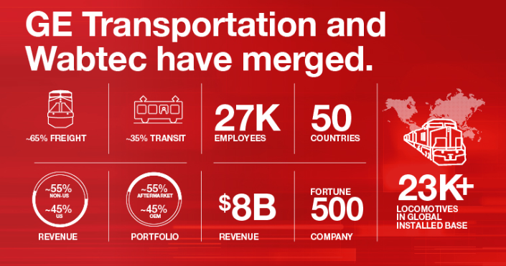


WABTEC, GLOBAL LEADER FOR RAIL
EQUIPMENT, SERVICES & SOFTWARE
Digital Solutions
Transport Intelligence
Installed base Highlights
17,000 locomotives monitored
10K IoT Edge Devices
12,000 Trip Optimizer Systems
THIS DOCUMENT AND ANY INFORMATION OR DESCRIPTIVE MATTER SET OUT HEREIN ARE THE CONFIDENTIAL AND COPYRIGHT PROPERTY OF WATEC AND SHALL NOT BE DISCLOSED, LOANED OR USED FOR MANUFACTURING, TENDERING OR ANY OTHER PURPOSE WITHOUT OUR WRITTEN PERMISSION

Slide 3
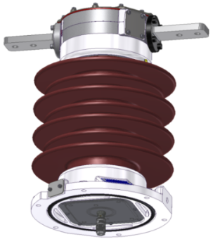

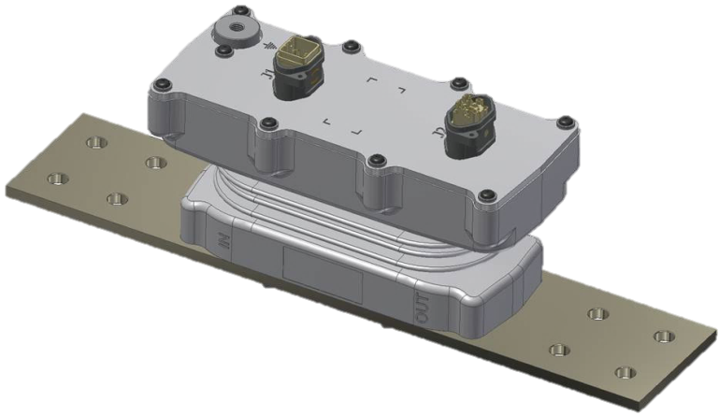


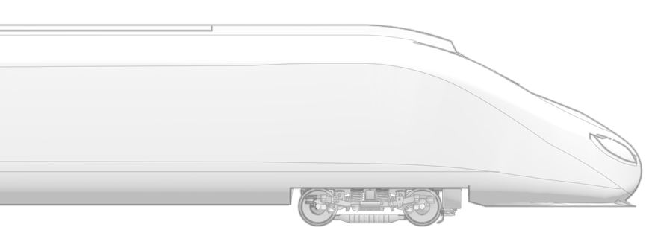


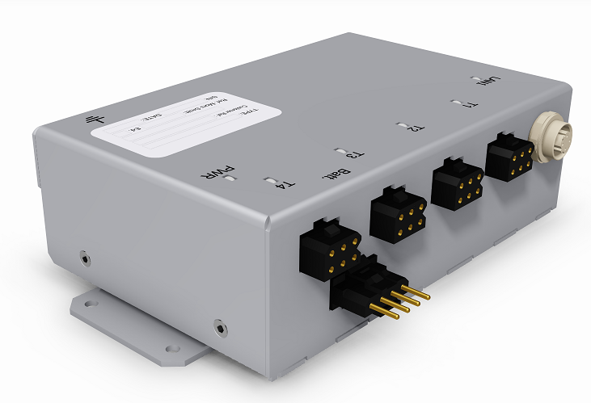
ENERGY MEASUREMENT COMPLETE SOLUTION
CATEnergy & Micrometer
CATEnergy AC & DC sensors
MicroMeter multi channel meter & gateway
→ Global Energy Consumed
→ Global Energy Regenerated
→ Detail Traction consumption
→ Detail Auxiliary consumption
→ Detail HVAC consumption
→ Detail Rheostatic brake
HVAC
Auxiliary inverter
Traction inverter
Rheostatic brake
∼
=
TCMS
M
M
THIS DOCUMENT AND ANY INFORMATION OR DESCRIPTIVE MATTER SET OUT HEREIN ARE THE CONFIDENTIAL AND COPYRIGHT PROPERTY OF WATEC AND SHALL NOT BE DISCLOSED, LOANED OR USED FOR MANUFACTURING, TENDERING OR ANY OTHER PURPOSE WITHOUT OUR WRITTEN PERMISSION

Slide 4
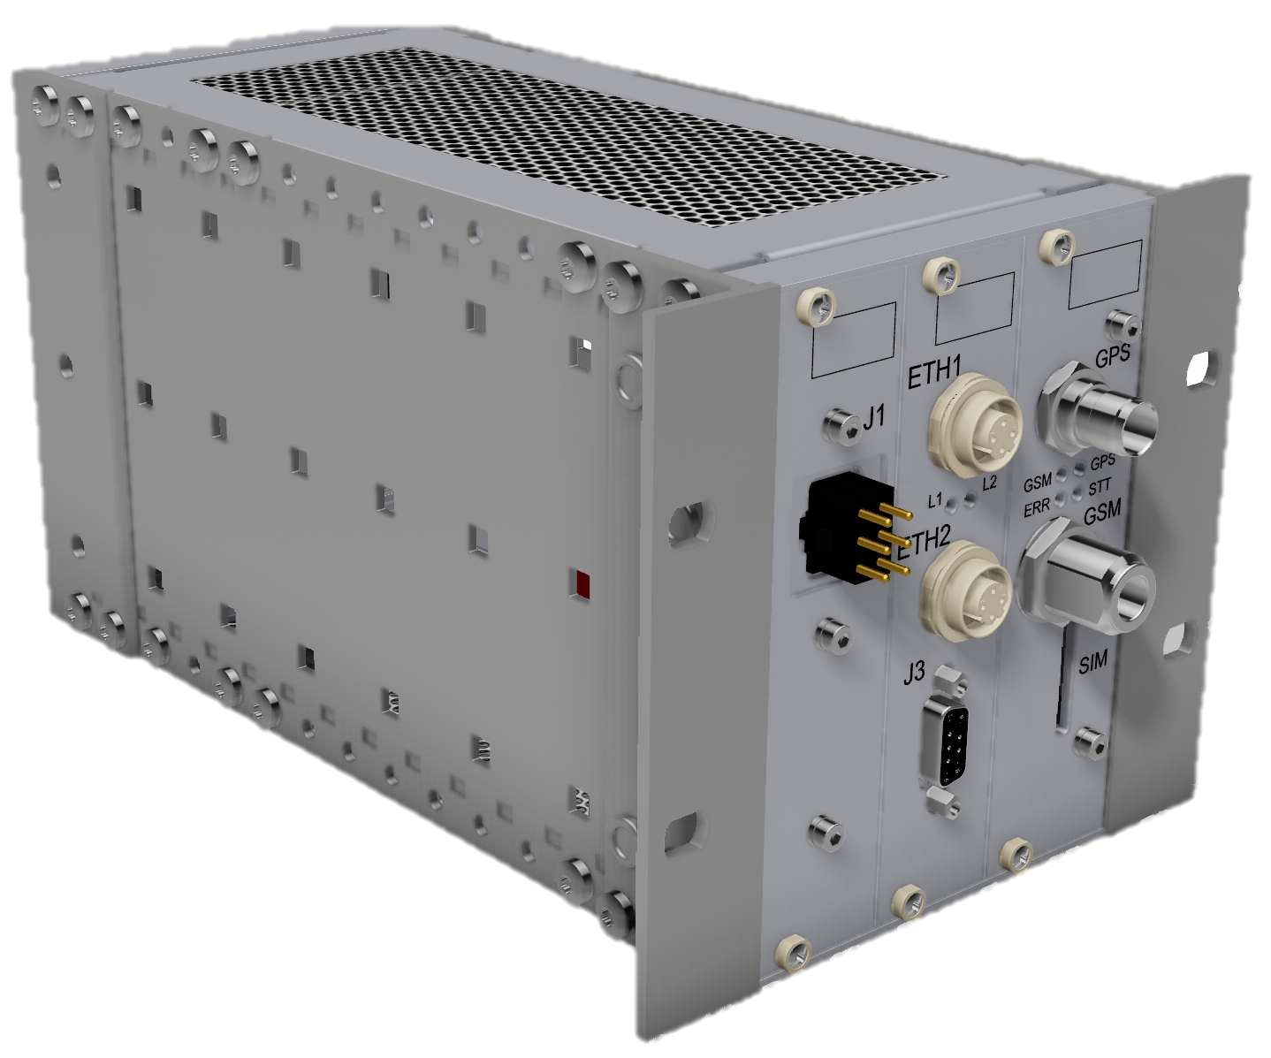
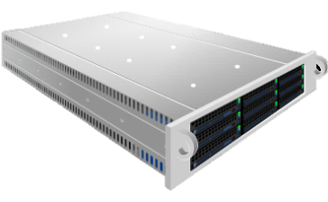

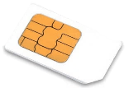
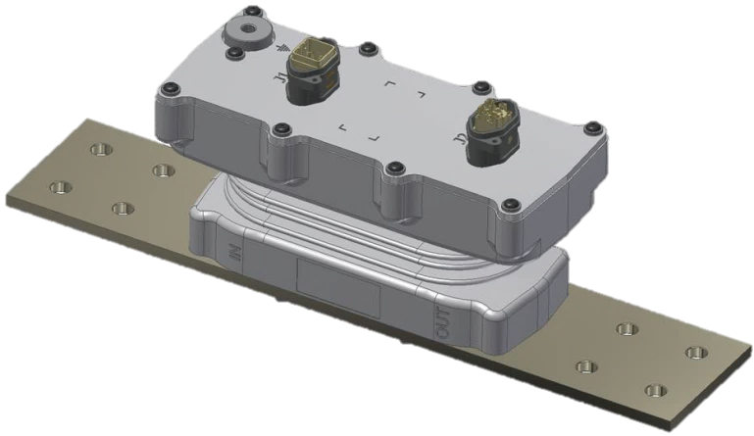

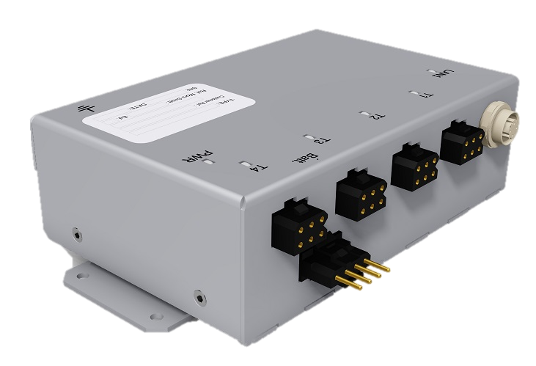


ENERGY VALUABLE DATA COMMUNICATION
DHS compliant EN 50463:2017
CEBD for billing
Reading block (Voltage, Current, Location, Acceleration, Temperature, etc.)
→ Communication to TCMS
→ Communication for Billing
→ Communication for management
Internet
→ Reading block with other sensor data
CEBD
Reading Block
Diagnostic
Reading Block
Diagnostic
Internet
CEBD
Reading block
Diagnostic
TCMS
THIS DOCUMENT AND ANY INFORMATION OR DESCRIPTIVE MATTER SET OUT HEREIN ARE THE CONFIDENTIAL AND COPYRIGHT PROPERTY OF WATEC AND SHALL NOT BE DISCLOSED, LOANED OR USED FOR MANUFACTURING, TENDERING OR ANY OTHER PURPOSE WITHOUT OUR WRITTEN PERMISSION

Slide 5
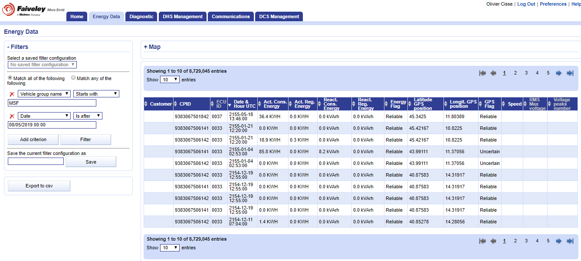
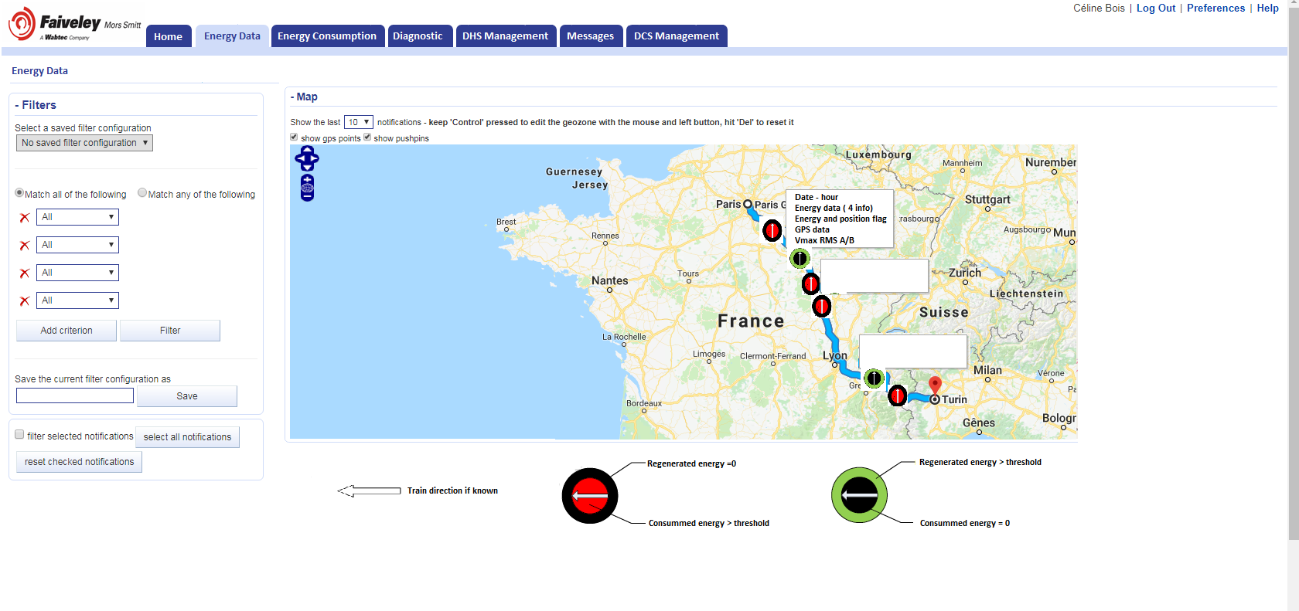

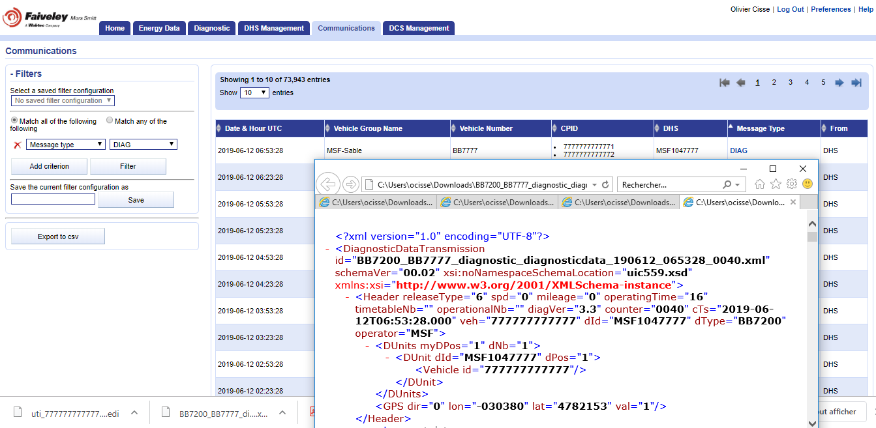


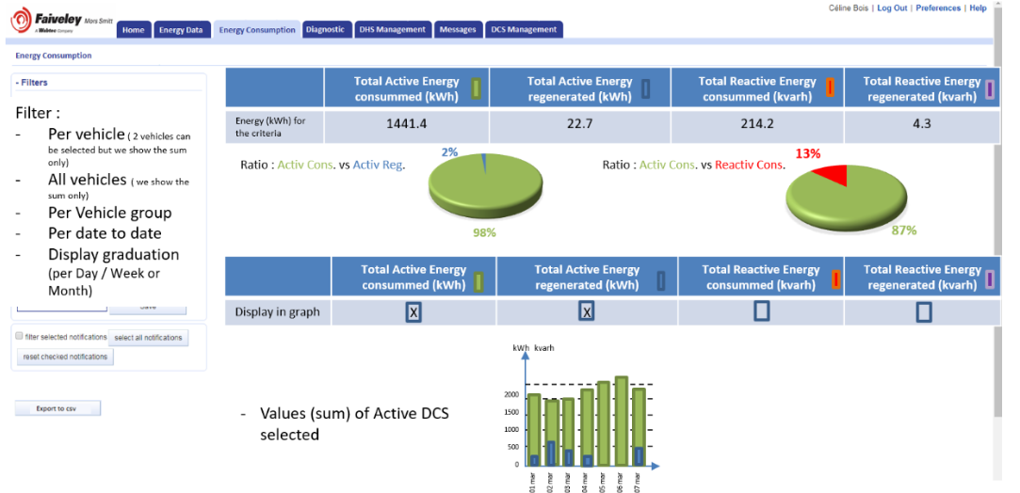


COMPLETE GROUND SERVICE FOR DATA
DCS WABTEC & SOFTWARE
Energy data Collecting Service
Web application for data management
Cybersecurity management
Energy and Diagnostic data
→ Data base filtering
→ Data localisation
→ Diagnostic data UIC559
→ Consumption Analysis
→ Data Exchange
Internet
THIS DOCUMENT AND ANY INFORMATION OR DESCRIPTIVE MATTER SET OUT HEREIN ARE THE CONFIDENTIAL AND COPYRIGHT PROPERTY OF WATEC AND SHALL NOT BE DISCLOSED, LOANED OR USED FOR MANUFACTURING, TENDERING OR ANY OTHER PURPOSE WITHOUT OUR WRITTEN PERMISSION

Slide 6
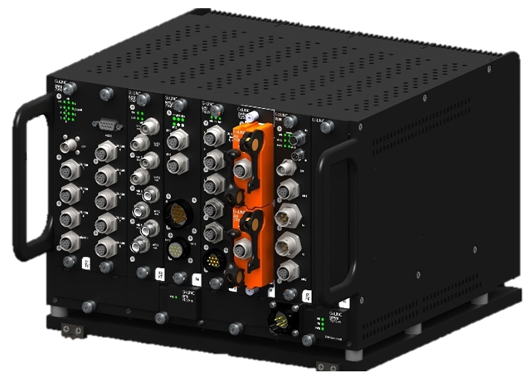
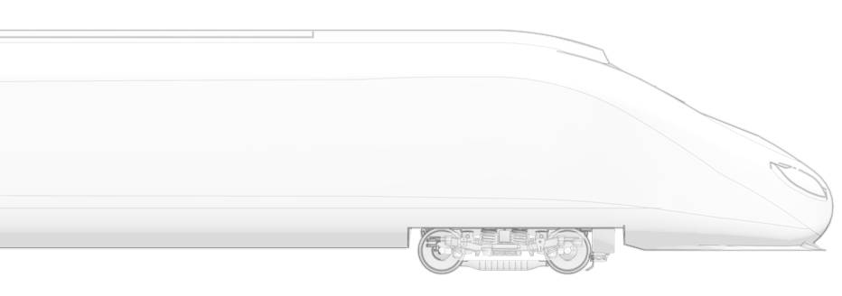
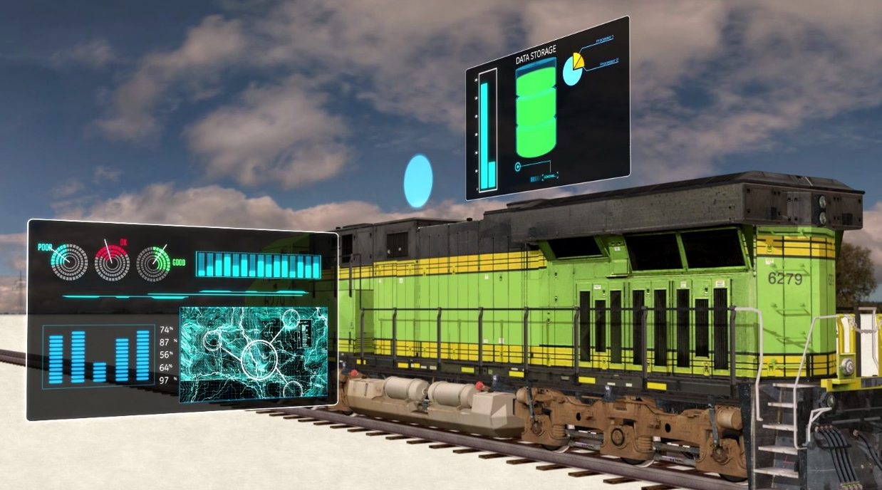
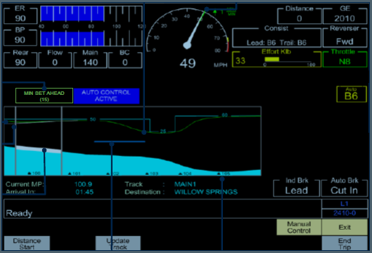
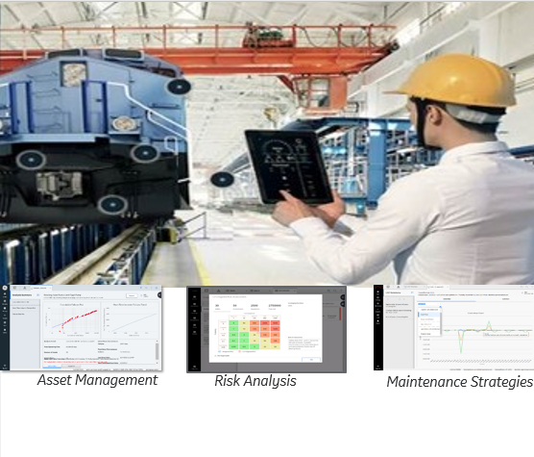
WABTEC Digital Transport Intelligence
GLOBAL DATA SERVICE
GoLINC HW Platform
Transport INTELLIGENCE
Train PERFORMANCE & EFFICIENCY
Network OPTIMIZATION
Risk ANALYSIS
→ Edge communication device, IOT
→ EdgeLINCTM data management
DHS
→ APM for real time CBM
Driver Advisory System – TripOptimizer
12 000 Traction unit fitted
2,2 Million Tons of CO2 Reduced
Internet
EdgeLINC SW Platform
TripOptimizer
Maintenance Strategy
THIS DOCUMENT AND ANY INFORMATION OR DESCRIPTIVE MATTER SET OUT HEREIN ARE THE CONFIDENTIAL AND COPYRIGHT PROPERTY OF WATEC AND SHALL NOT BE DISCLOSED, LOANED OR USED FOR MANUFACTURING, TENDERING OR ANY OTHER PURPOSE WITHOUT OUR WRITTEN PERMISSION
Network Optimization
Real-time network planning and optimization of mainline, yards, terminals

Slide 7
Olivier Cissé
Marketing Director,
EMS business developer
Mors Smitt France
Tel.: +33 (0) 629 961 426
Mail: ocisse@wabtec.com
Thank you for your attention.

