Slide 1
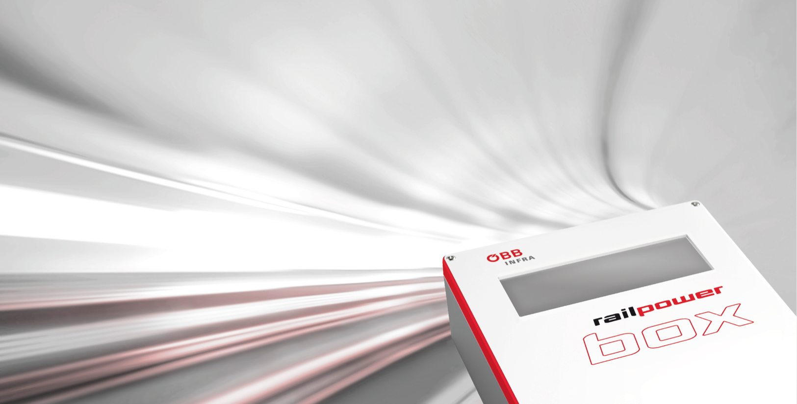

Slide 2
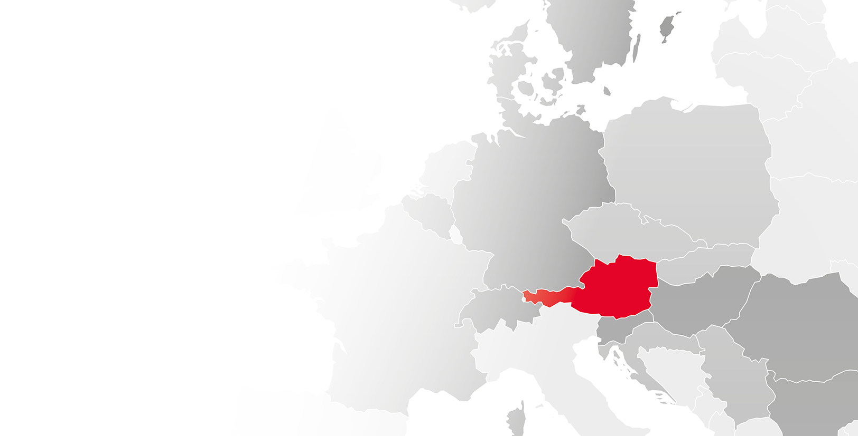
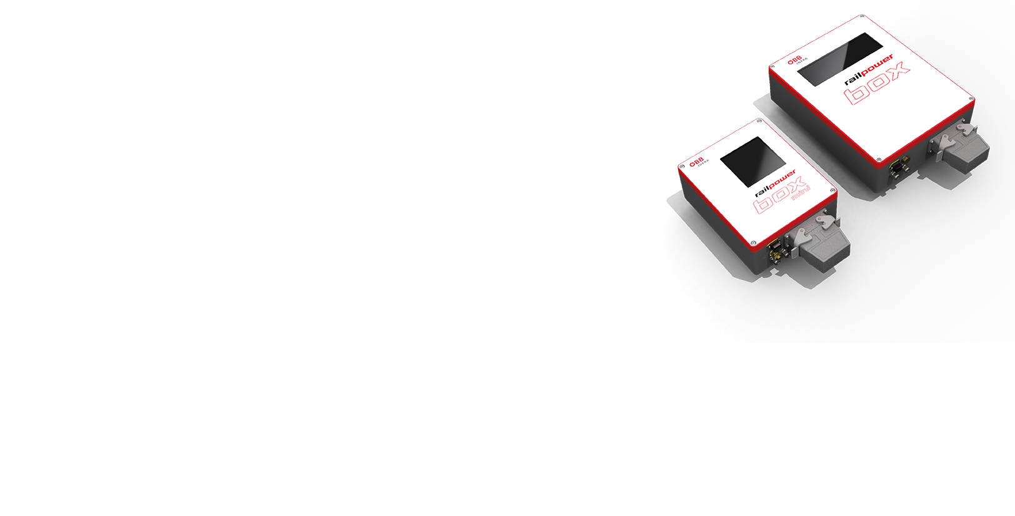
railpower box
Settlement and Billing in 14 countries
Over 1,300 units installed
More than 30 customers all over Europe

Slide 3
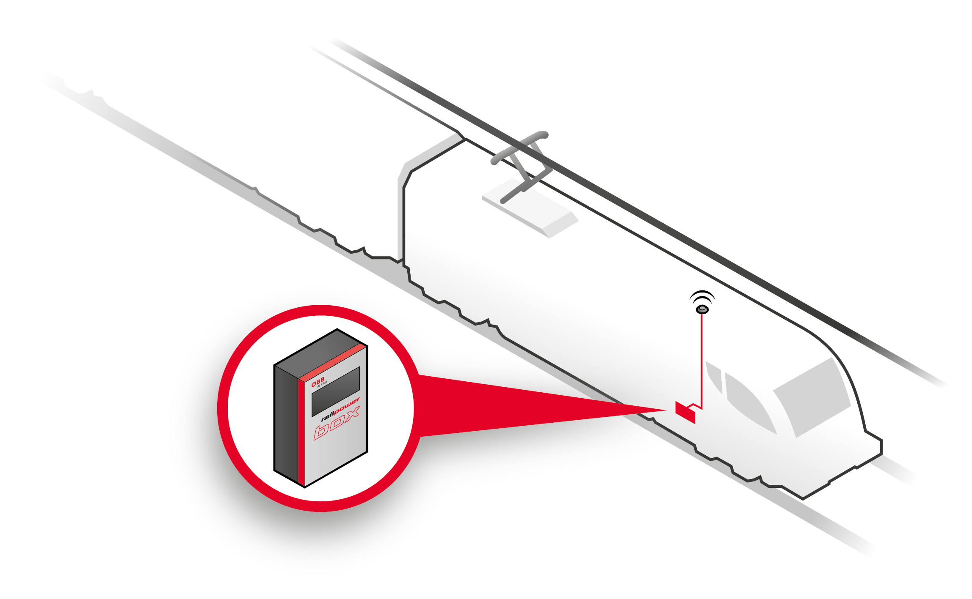
Support Services
The ÖBB-Infrastruktur AG bears the investment costs for the railpower box and provides the railway untertakings with the system for a monthly measurement fee
Measurement fee includes
Hardware and software of the railpower box incl. all components
Training of a Europe wide service stations network for the installation/replace
Remote monitoring of the equipments, immediate feedback to the direct/indirect customer.
Spare parts management - for any mulfunction, a replace box will be sent
Access to the internet application railpower client (desktop / mobile) for a 24/7 review of energy and position data
Data exchange with other infrastructure managers and energy providers such as DB (Germany), SBB (Switzerland), EREX (Denmark, Belgium, Norway, Sweden, Finnland, Netherlands), MAV (Hungary), Slowenia, Czech Republic, Romania, Bulgaria.
The railway undertaking bears the installation costs
Support for the first installation by ÖBB-Infrastruktur AG (Installation documents, video tutorial, online or on-site support)
Provision of the documentation for the conformity assessment

Slide 4
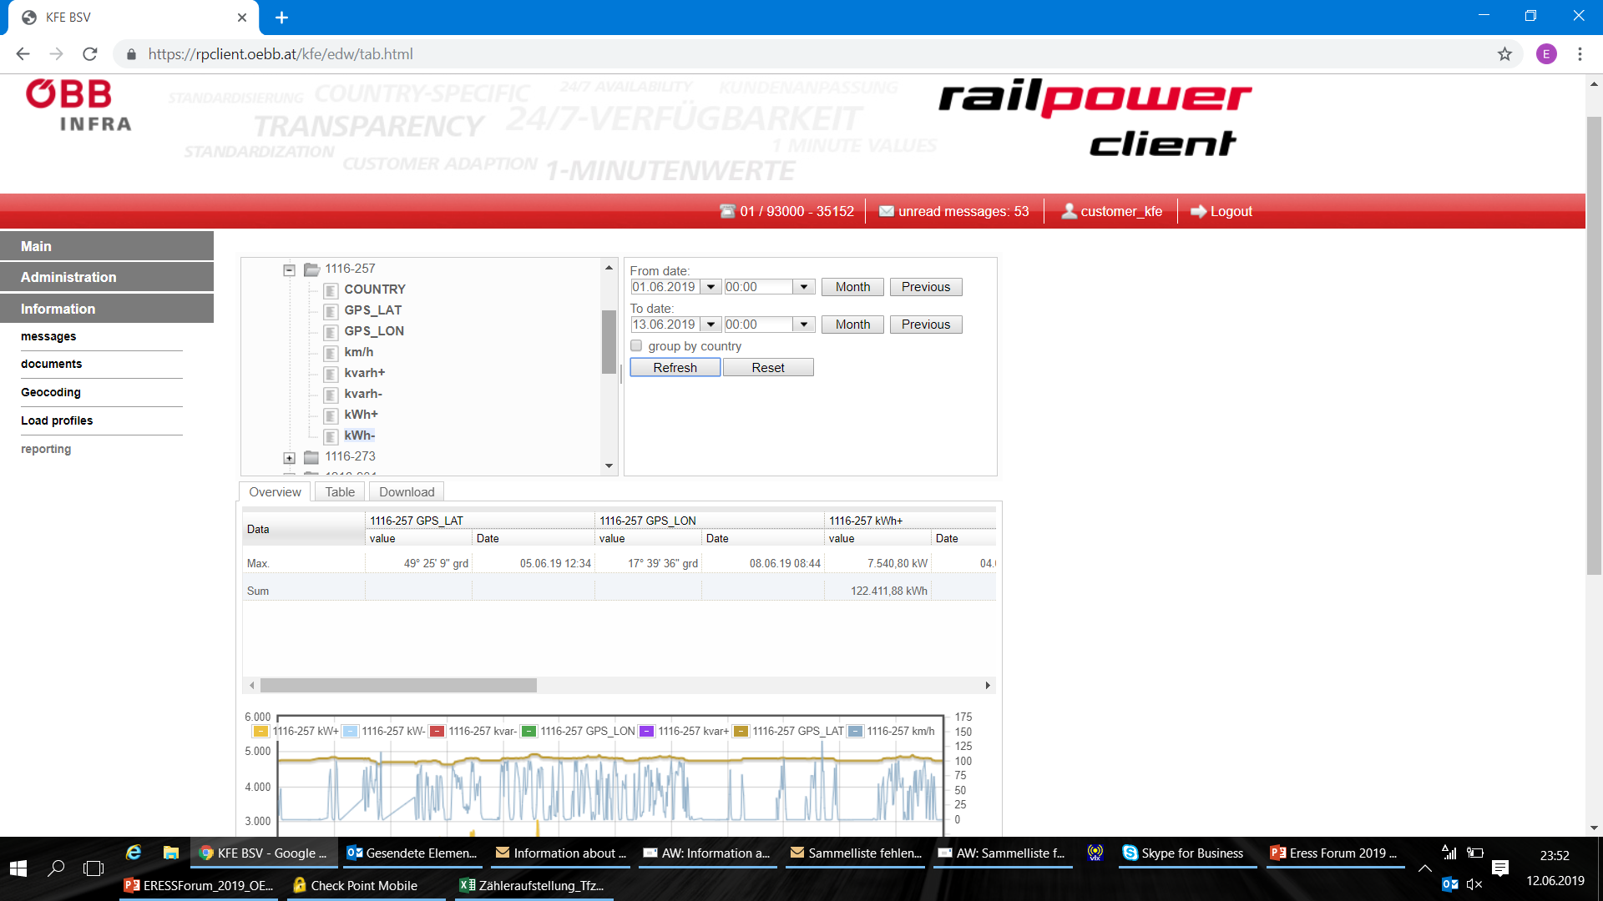
New Developments
Support of the EN50463:2017 norm by railpower box
Increase the quality of support services
Higher granularity of energy and position data
Extended acsessibility of the data

Slide 5
Portfoliomanagement

