Slide 1
The big picture

Slide 2
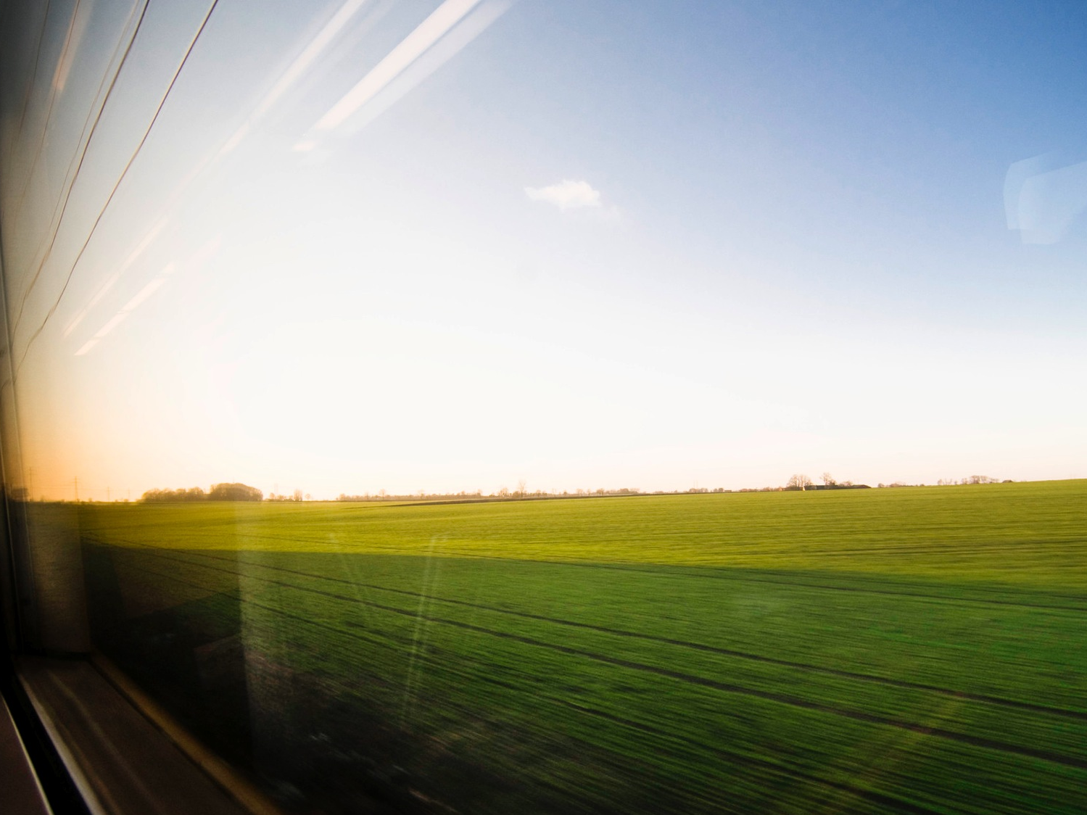
Today’s Situation
Rapid digitalisation
Environmental legislation - key EU targets for 2030:
Min. 40% cut in greenhouse gas emissions compared with 1990
Min. 27% of total energy consumption from renewable energy
Min. 27% increase in energy efficiency
Notes:
Notes:
All that can be digitalised, will be digitalised, both in public and private sector.
How does the railway sector help? Huge potential vs. sad reality…

Slide 3
More collaboration is needed

Slide 4
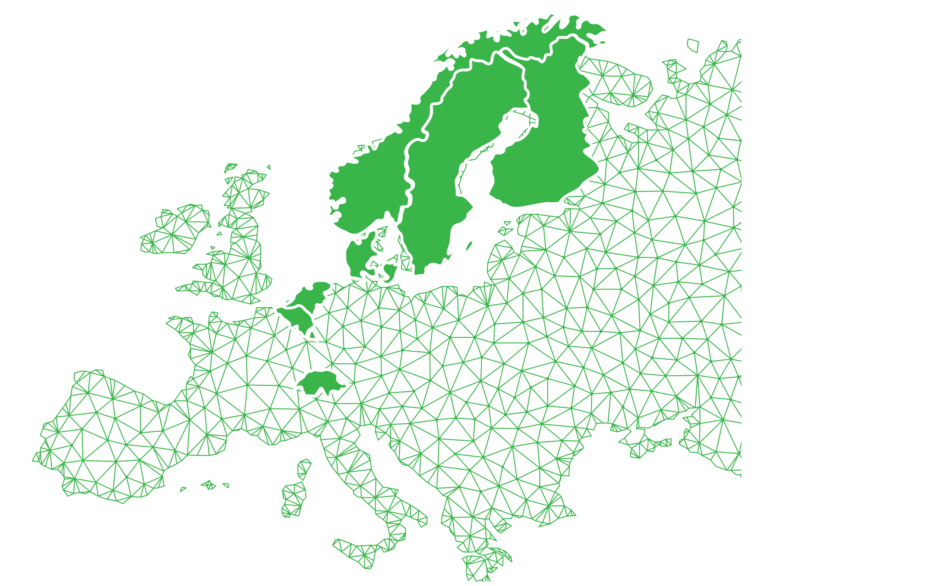
Sweden
Norway
Finland
Denmark
Netherlands
Belgium
Switzerland

