Slide 1
EU Railway Energy Statistics 2019:
Status on energy metering, DCS, exchange and settlement
June 13th 2019, Brussels
Raimondo Orsini,
Sustainable Development Foundation

Slide 2
European railway energy performance
Who are the survey respondents?
Energy meters: are we moving forward?
Overview on energy settlement and management
Data Collecting System
Progress on Energy Settlement System
What do we expect about the future?

Slide 3
European railway energy performance

Slide 4
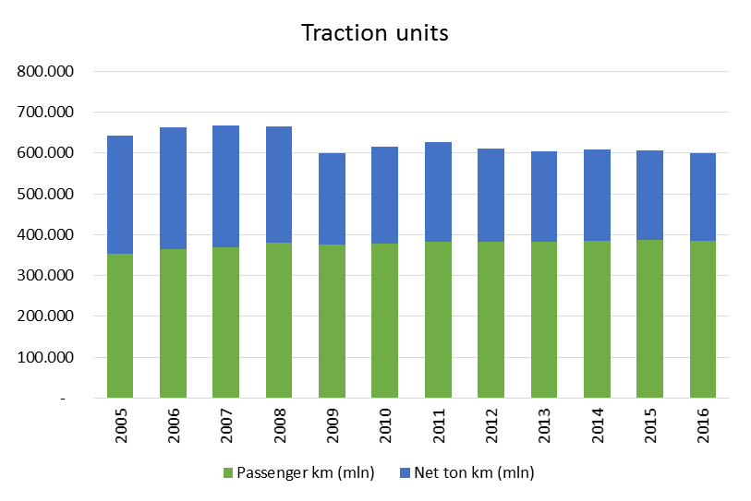
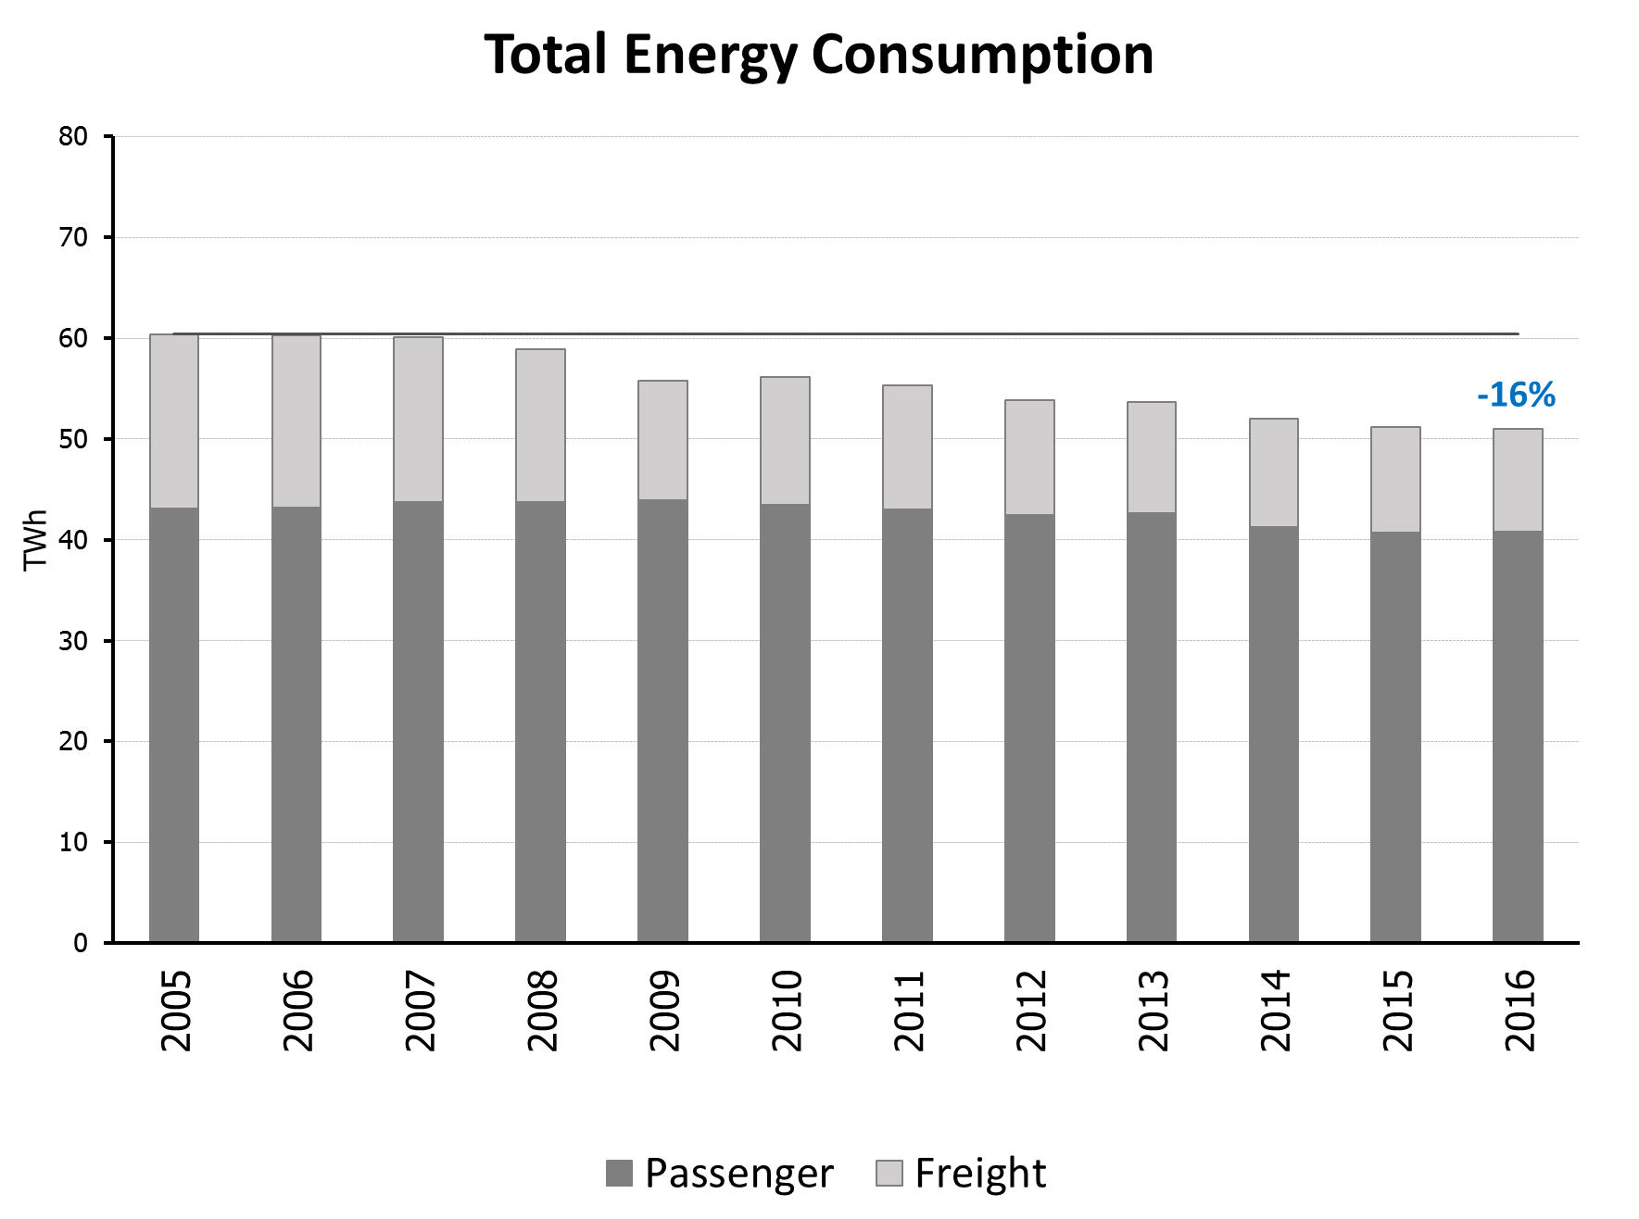
European railway energy consumption and production

Slide 5
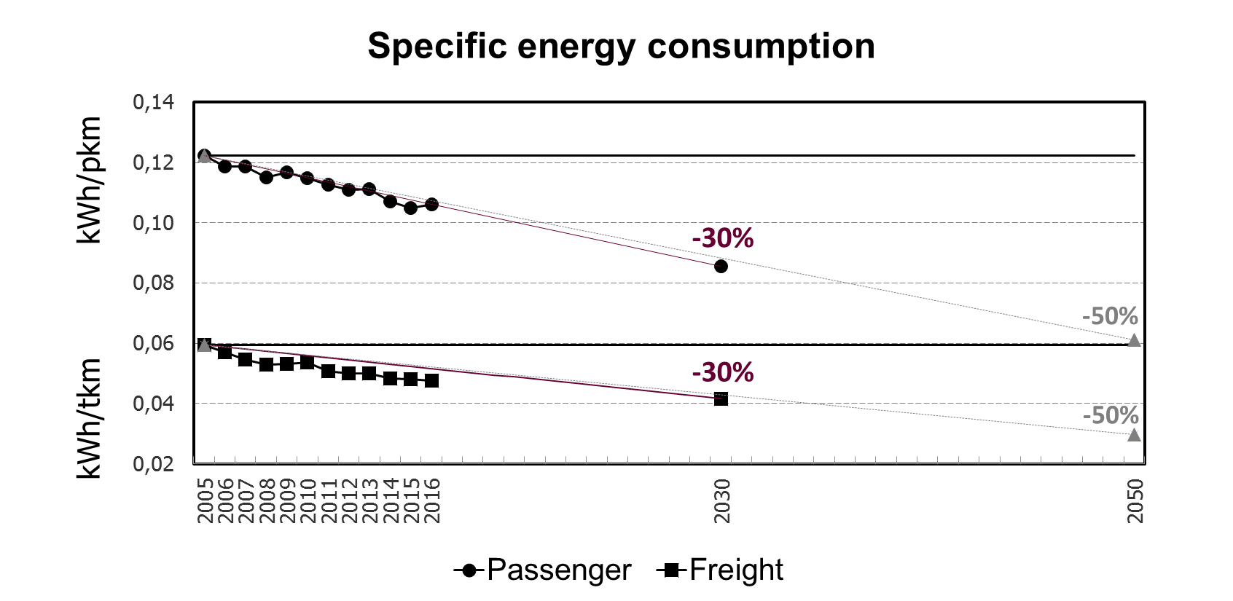
UIC-CER Commitment: target on specific energy consumption
Targets of specific energy consumption reduction (passenger and freight):
-30% in 2030
-50% in 2050

Slide 6
Who are the ERESS survey respondents?

Slide 7
The survey respondents
The survey consists of 27 questions and it has been sent by email to energy managers belonging to different types of companies.
The report has been made up with the answers received from:
17 European countries covered
25 respondents

Slide 8
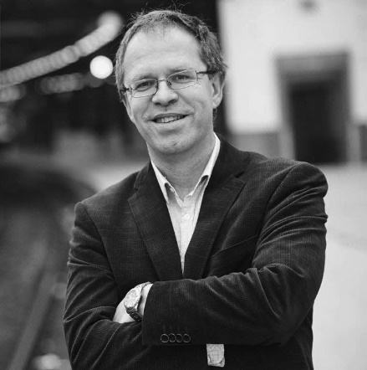
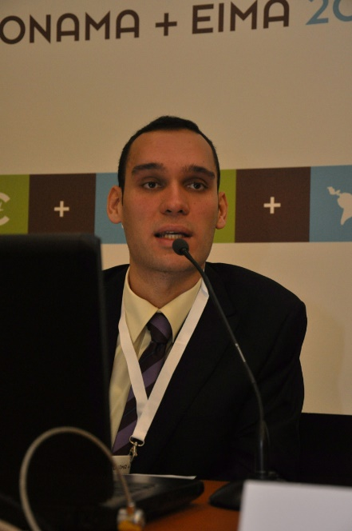
Some of them are really mysterious….
UNKNOWN
UNKNOWN
UNKNOWN
UNKNOWN
UNKNOWN

Slide 9
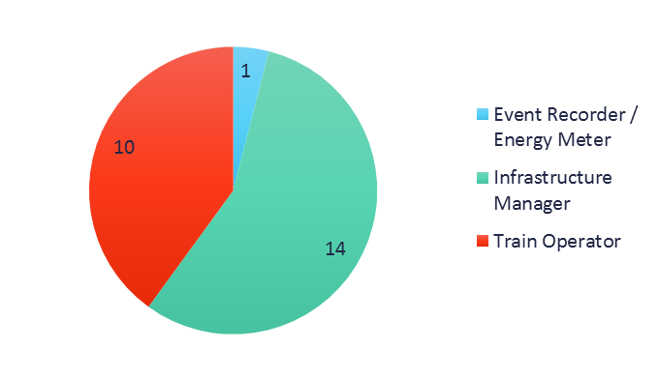
Where do you work? I work for…
 | Event Recorder / Energy Meter | Infrastructure Manager | Train Operator
Austria |  | 1
Belgium |  | 1 | 1
Czech Republic |  | 1 | 1
Finland |  | 1
France |  | 1 | 1
Germany |  |  | 1
Greece |  | 1
Italy |  | 1 | 1
Luxemburg |  |  | 1
Netherlands |  |  | 1
Norway |  | 1
Poland |  | 1
Romania |  | 1
Slovakia |  | 2 | 2
Spain |  |  | 1
Switzerland | 1 | 1
UK |  | 1
Total | 1 | 14 | 10

Slide 10
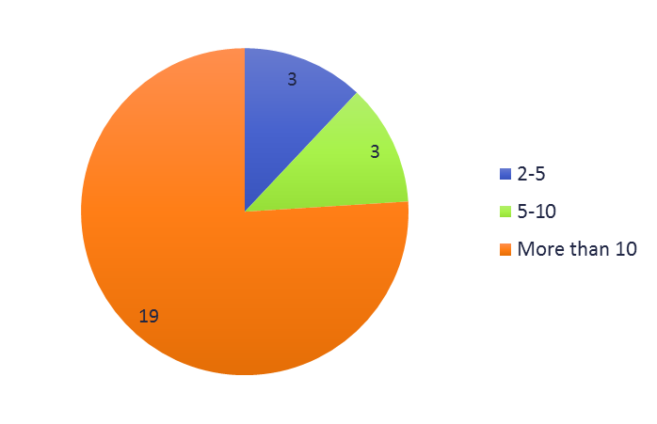
How many operators do you have in your country?

Slide 11
Energy meters: are we moving forward?

Slide 12
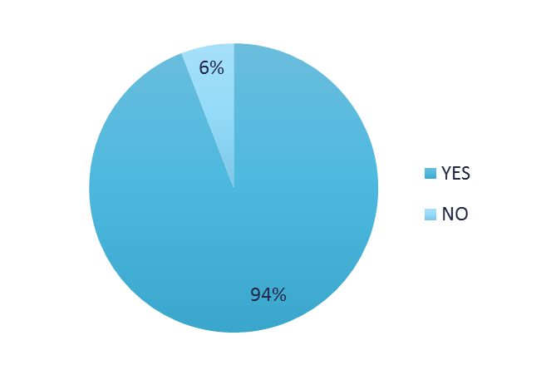
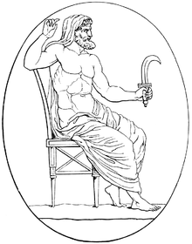
Do you have energy meters on trains in your country?
For those who have not yet energy meters on their trains, “When are you planning to start installing energy meters? “
SOON…

Slide 13
How many energy meters do you have on board your traction units in your country today? And how many do you expect to have in 2020?
 | 2017 | 2018 | 2019 | Expected in 2020
Austria | > 500 | > 500 | > 500 | > 500
Belgium | 20-100 | 20-100 | 20-100 | 100-500
Czech Republic | 100-500 | 100-500 | 100-500 | 100-500
Finland | 1-20 | 100-500 | 100-500 | 100-500
France | 100-500 | 100-500 | > 500 | > 500
Germany | > 500 | > 500 | > 500 | > 500
Greece | n.a. | n.a. | 0 | 0
Italy | 20-100 | 20-100 | 100-500 | 100-500
Luxemburg | n.a. | 1-20 | 20-100 | 20-100
Netherlands | 20-100 | 20-100 | 100-500 | 100-500
Norway | 100-500 | 100-500 | > 500 | > 500
Poland | > 500 | n.a. | > 500 | > 500
Romania | n.a. | > 500 | > 500 | > 500
Slovakia | 100-500 | 100-500 | 100-500 | 100-500
Spain | 100-500 | 100-500 | 100-500 | 100-500
Sweden | 100-500 | 100-500 | n.a. | n.a.
Switzerland | 100-500 | 100-500 | 100-500 | > 500
UK | > 500 | > 500 | > 500 | > 500

Slide 14
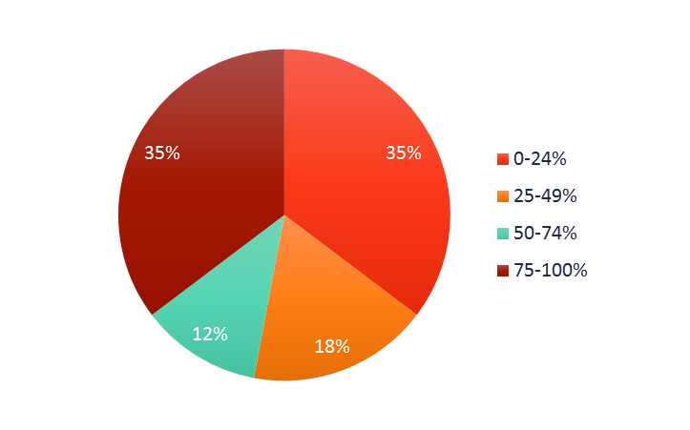
What is the percentage of meters that are TSI compliant?
In more than half of countries covered, less than 50% of meters are TSI compliant.

Slide 15
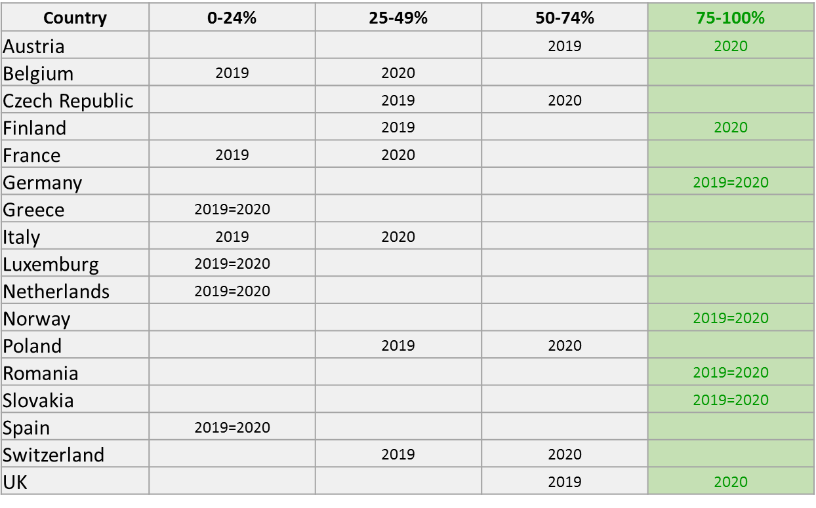
What is the percentage of traction units equipped with meters in your country today? And what is the percentage do you expect in 2020?

Slide 16
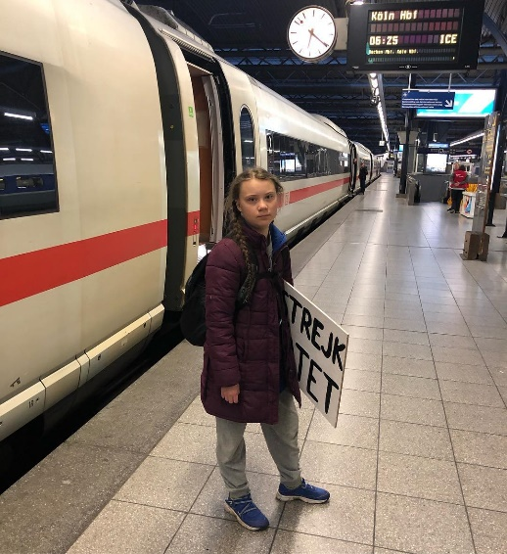
What are you waiting to reach the 100%?

Slide 17
KEY MESSAGES
The number of energy meters is constantly growing and it is expected to grow in 2020 for 6 countries: Belgium, France, Italy, Netherlands, Norway, Switzerland.
Half of the countries covered will have 75-100% of traction units equipped with meters within 2020.
We still don’t know the exact number of meters in Europe: a goal for ERESS 2020?
The percentage of meters “TSI compliant” is still not high in the majority of country covered.

Slide 18
Overview on energy settlement and management

Slide 19
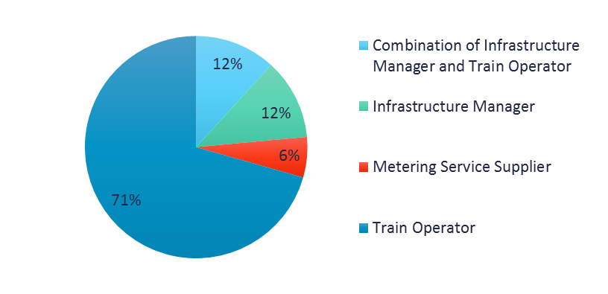
Who is the owner of energy meters on trains in your country?

Slide 20
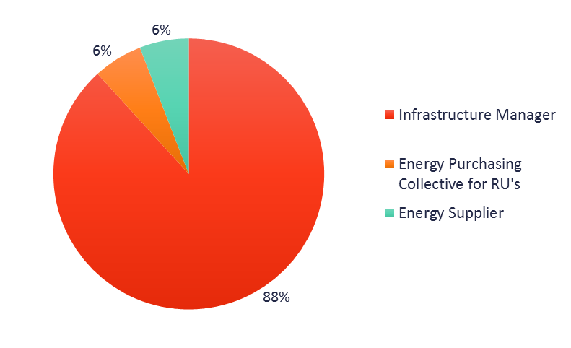
Who is responsible for the settlement and billing of traction energy in your country?

Slide 21
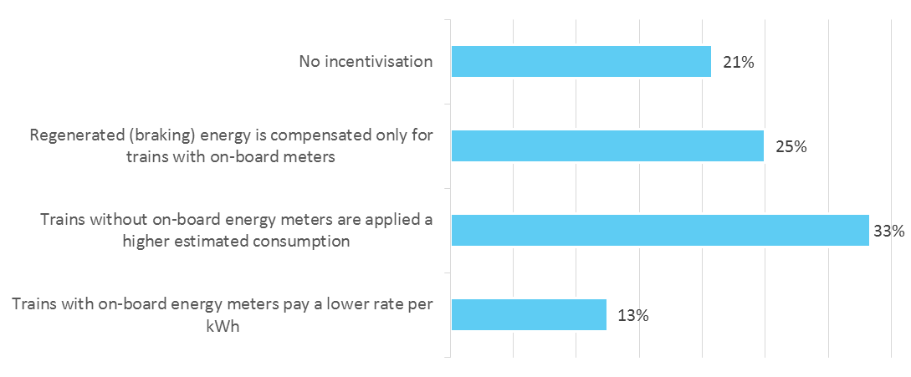
How is the installation of on-board energy meters incentivised in your country?*
* Multiple choice allowed

Slide 22
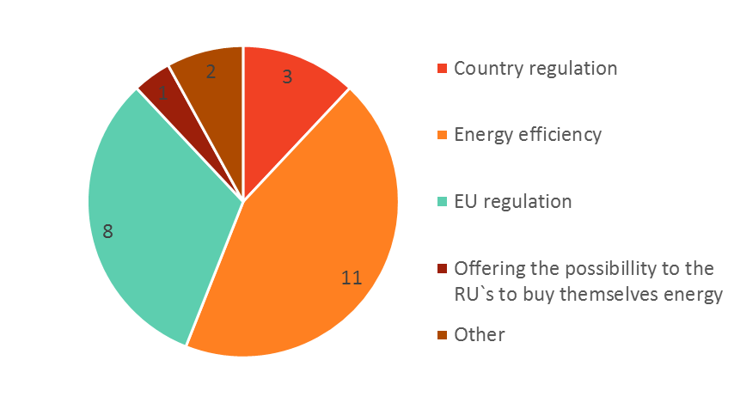
What is in your opinion the main driver for the implementation of a rail energy billing system?

Slide 23
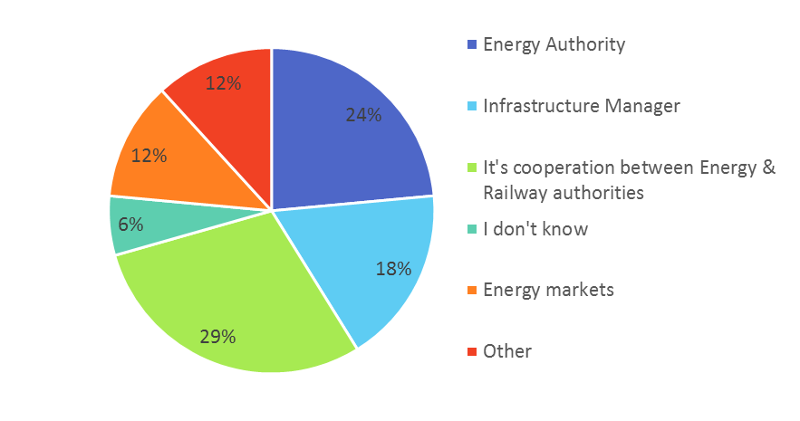
Who defines the railway energy prices in your country?

Slide 24
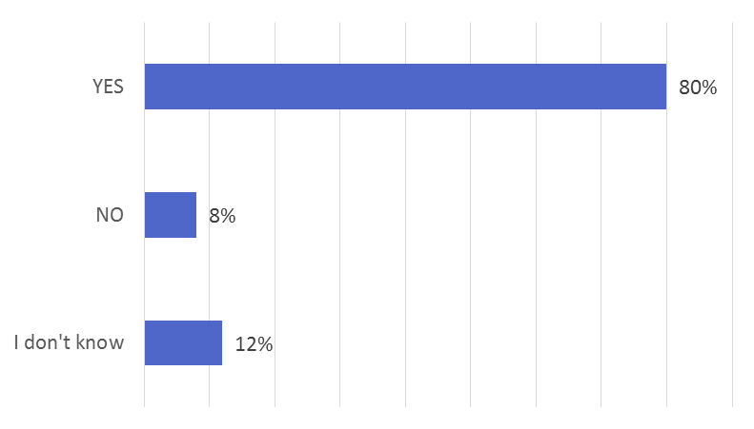
Did your organization set any target to improve energy efficiency or to reduce CO2 emissions?
WELL DONE!

Slide 25
KEY MESSAGES
The installation of energy meters is incentivised in several ways.
80% of the organizations has set targets to reduce CO2 emissions.
Energy efficiency is the main driver for the implementation of a rail energy billing system, followed by the EU regulation.

Slide 26
Data Collecting System

Slide 27
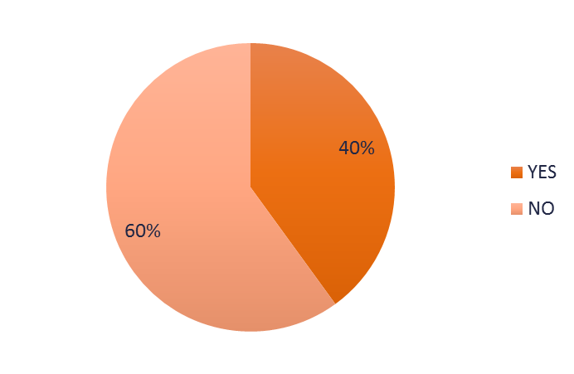
Does your organization own a Data Collection System (DCS) capable of collecting data according to the interoperable protocol of last year?
For those who answered NO: “When are you planning to have such a DCS?“
After 2022 | Before 2022 | I don't know
Greece (IM) | Austria (IM) | Germany (TO)
 | Czech Republic (IM) | Luxemburg (TO)
 | Finland (IM) | Slovakia (TO)
 | France (IM) | Switzerland
 | Poland (IM) | UK (IM)
 |  | Romania (IM)

Slide 28
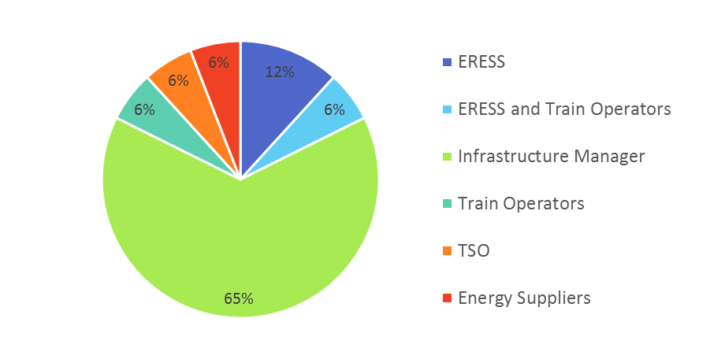
Who owns or will own the Data Collection System (DCS) in your country?

Slide 29
If there are installed meters in your country, do you have any challenge with the following issues?
Infrastracture Manager | RANKING | Train Operator
Validating that the data coming from energy meters is correct | 1° | Exchanging data inside the country for billing purposes
Exchanging data internationally for billing purposes | 2° | Exchanging data internationally for billing purposes
Allocating this data correctly | 3° | Allocating this data correctly
Exchanging data inside the country for billing purposes | 4° | Validating that the data coming from energy meters is correct
2018
2018
2018
2018
2018
2018

Slide 30
KEY MESSAGES
40% of the respondents already own or will own a DCS.
5 Infrastructure Managers are planning to have such a DCS before 2022: Austria, Czech Republic, Finland, France, Poland.
As in 2017 and in 2018, the biggest challenge according to IMs is to validate data coming from energy meters are correct (What is the development of this issue?)
IMs and RUs have opposite priorities to solve….
ERESS (or ERESS in combination with the Train Operator) is “well positioned”.

Slide 31
Progress on Energy Settlement System

Slide 32
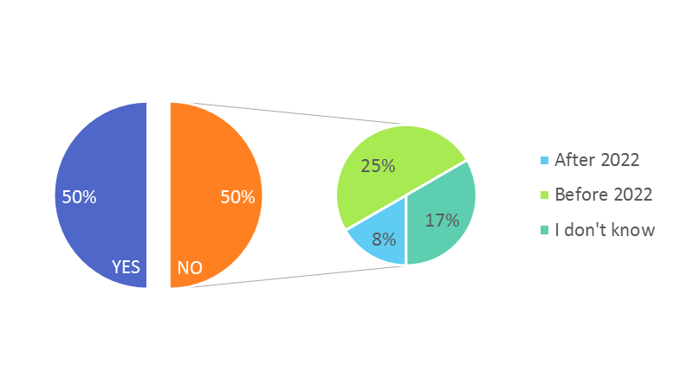
Do you have an Energy Settlement System to correctly handle metering data from trains for billing purposes?
For those who answered NO: “When are you planning to have an Energy Settlement System in place?”

Slide 33
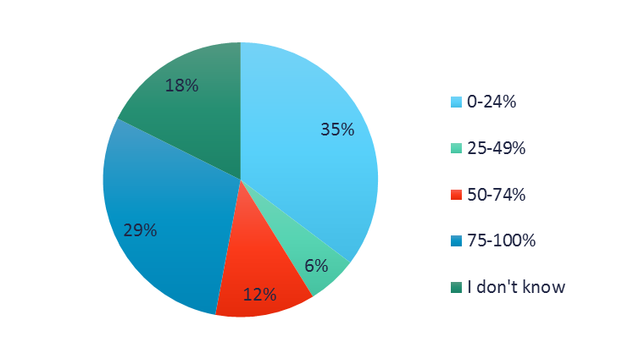
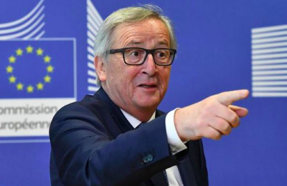
Which is the percentage of validated data, coming from energy meters, that is used for invoicing Train Operators in your country?
In your country are international trains obliged to have on-board energy meters?
“YES”: France, Germany
“NO”: Austria, Belgium, Czech Republic, Finland, Greece, Italy, Netherlands, Norway, Poland, Romania, Slovakia, Spain, Switzerland, UK

Slide 34
KEY MESSAGES
75% of respondents will have an Energy Settlement System before 2022:
50% already have it
25% are planning to
The percentage of validated data, coming from energy meters, that is used for invoicing Train Operators is not high in most cases.
What should be increased? The percentage of validated data used for invoicing Train Operators or the amount of data coming from energy meters?

Slide 35
What do you expect about the future?

Slide 36
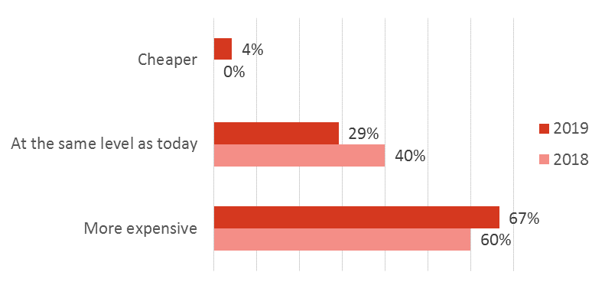
How do you think railway energy prices will be in your country in 2025? Railway energy prices will be:
In 2019:
 | Train Operator | Infrastructure Manager | Event Recorder / Energy Meter | TOT
Cheaper | 0% | 4% | 0% | 4%
At the same level as today | 20% | 8% | 0% | 29%
More expensive | 36% | 28% | 4% | 67%

Slide 37
How do you think railway energy in your country will look in 2025? There will be:
Infrastructure Manager | RANKING | Train Operator
An Energy Settlement System in place handling metering data from trains | 1° | National rules will still regulate the railway market
Traction energy bills based on real energy consumption | 2° | More Train Operators running in the country
Non-discriminatory railway energy distribution tariffs | 3° | A Data Collection System(s) in place
A Data Collection System(s) in place | 4° | An Energy Settlement System in place handling metering data from trains
Transparency of railway energy prices (open market for energy also in railway market) | 5° | Non-discriminatory railway energy distribution tariffs
More Train Operators running in the country | 6° | Traction energy bills based on real energy consumption
Free choice of energy suppliers for Train Operators or direct access to the energy market | 7° | Free choice of energy suppliers for Train Operators or direct access to the energy market
National rules will still regulate the railway market | 8° | Transparency of railway energy prices (open market for energy also in railway market)
2018
2018
2018
2018
2018
2018

Slide 38
What topics needs the most focus/are the biggest challenge in order to enable competition in the railway energy section?
BY 2020 | RANKING | BY 2025
Data Collection System in place | 1° | Having installed energy meters on all trains
Energy Settlement System in place handling metering data from trains | 2° | Energy Settlement System in place handling metering data from trains
Having installed energy meters on all trains | 3° | National regulation
Transparency of railway energy prices | 4° | Data Collection System in place
National regulation | 5° | Transparency of railway energy prices

Slide 39
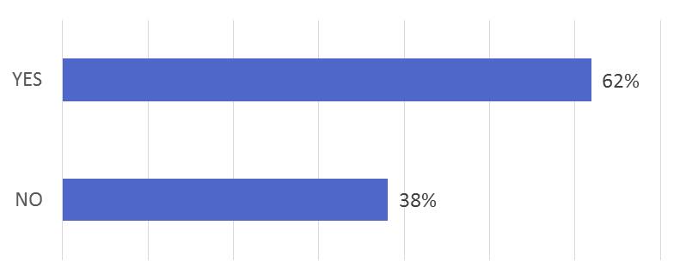
Do you think that the national regulation in your country should be improved to meet EU requirements?
In detail…
YES | NO
Czech Republic | Austria
Germany | Belgium
Greece | Finland
Italy | France
Netherlands | Slovakia (IM)
Norway | Switzerland (IM)
Poland | UK
Romania
Slovakia (IM & TOs)
Spain
Switzerland (Event Recorder)

Slide 40
KEY MESSAGES
Both IM and RU look forward to having soon:
-Data Collection System in place,
-Energy Settlement System in place handling metering data from trains
-Installed energy meters on all trains
A higher percentage of respondents expects that the railway energy prices will be higher in 2025.
62% of respondents think that in their country the national regulation is not enough to meet EU requirements.

Slide 41
Thanks for the attention!
June 13th 2019, Brussels
Raimondo Orsini,
Sustainable Development Foundation

