Slide 1
Energy Metering @ SBB
John Hegarty
ERESS Forum, 13. June 2019

Slide 2
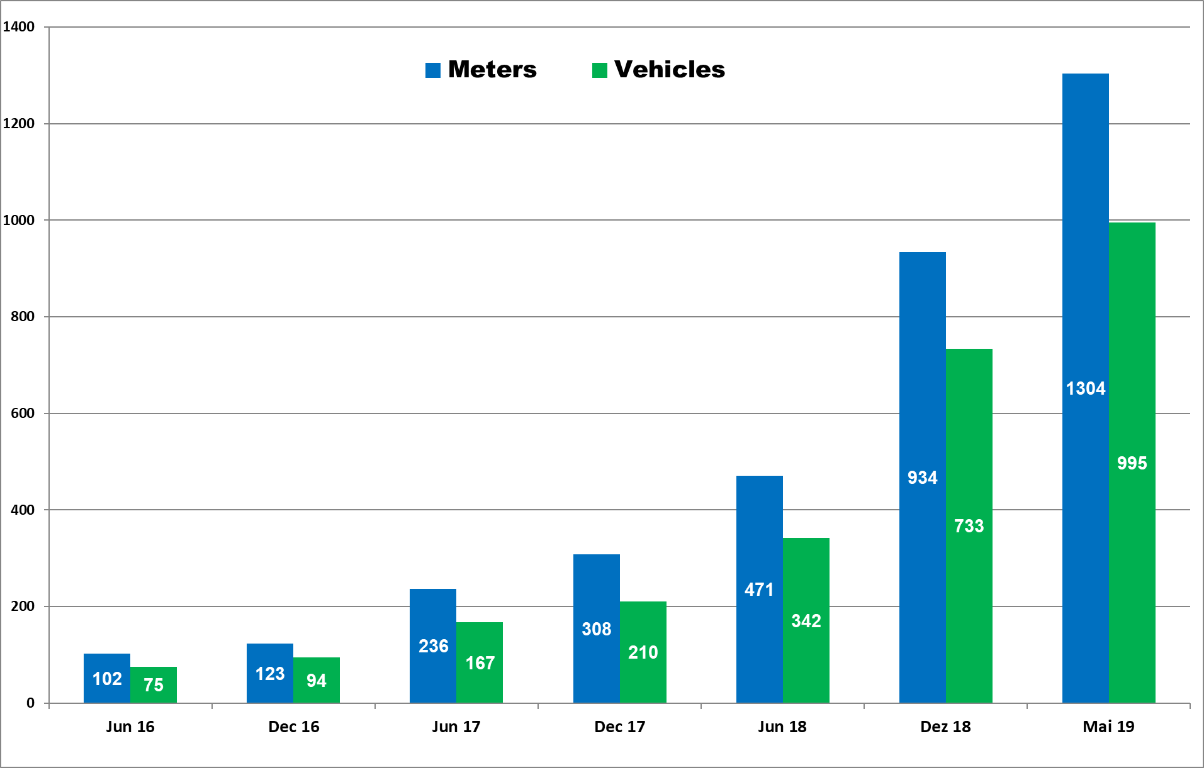
SBB Project - Meter Installations 2016-2019
SBB • Infrastructure • Energie • 06-2019
2

Slide 3
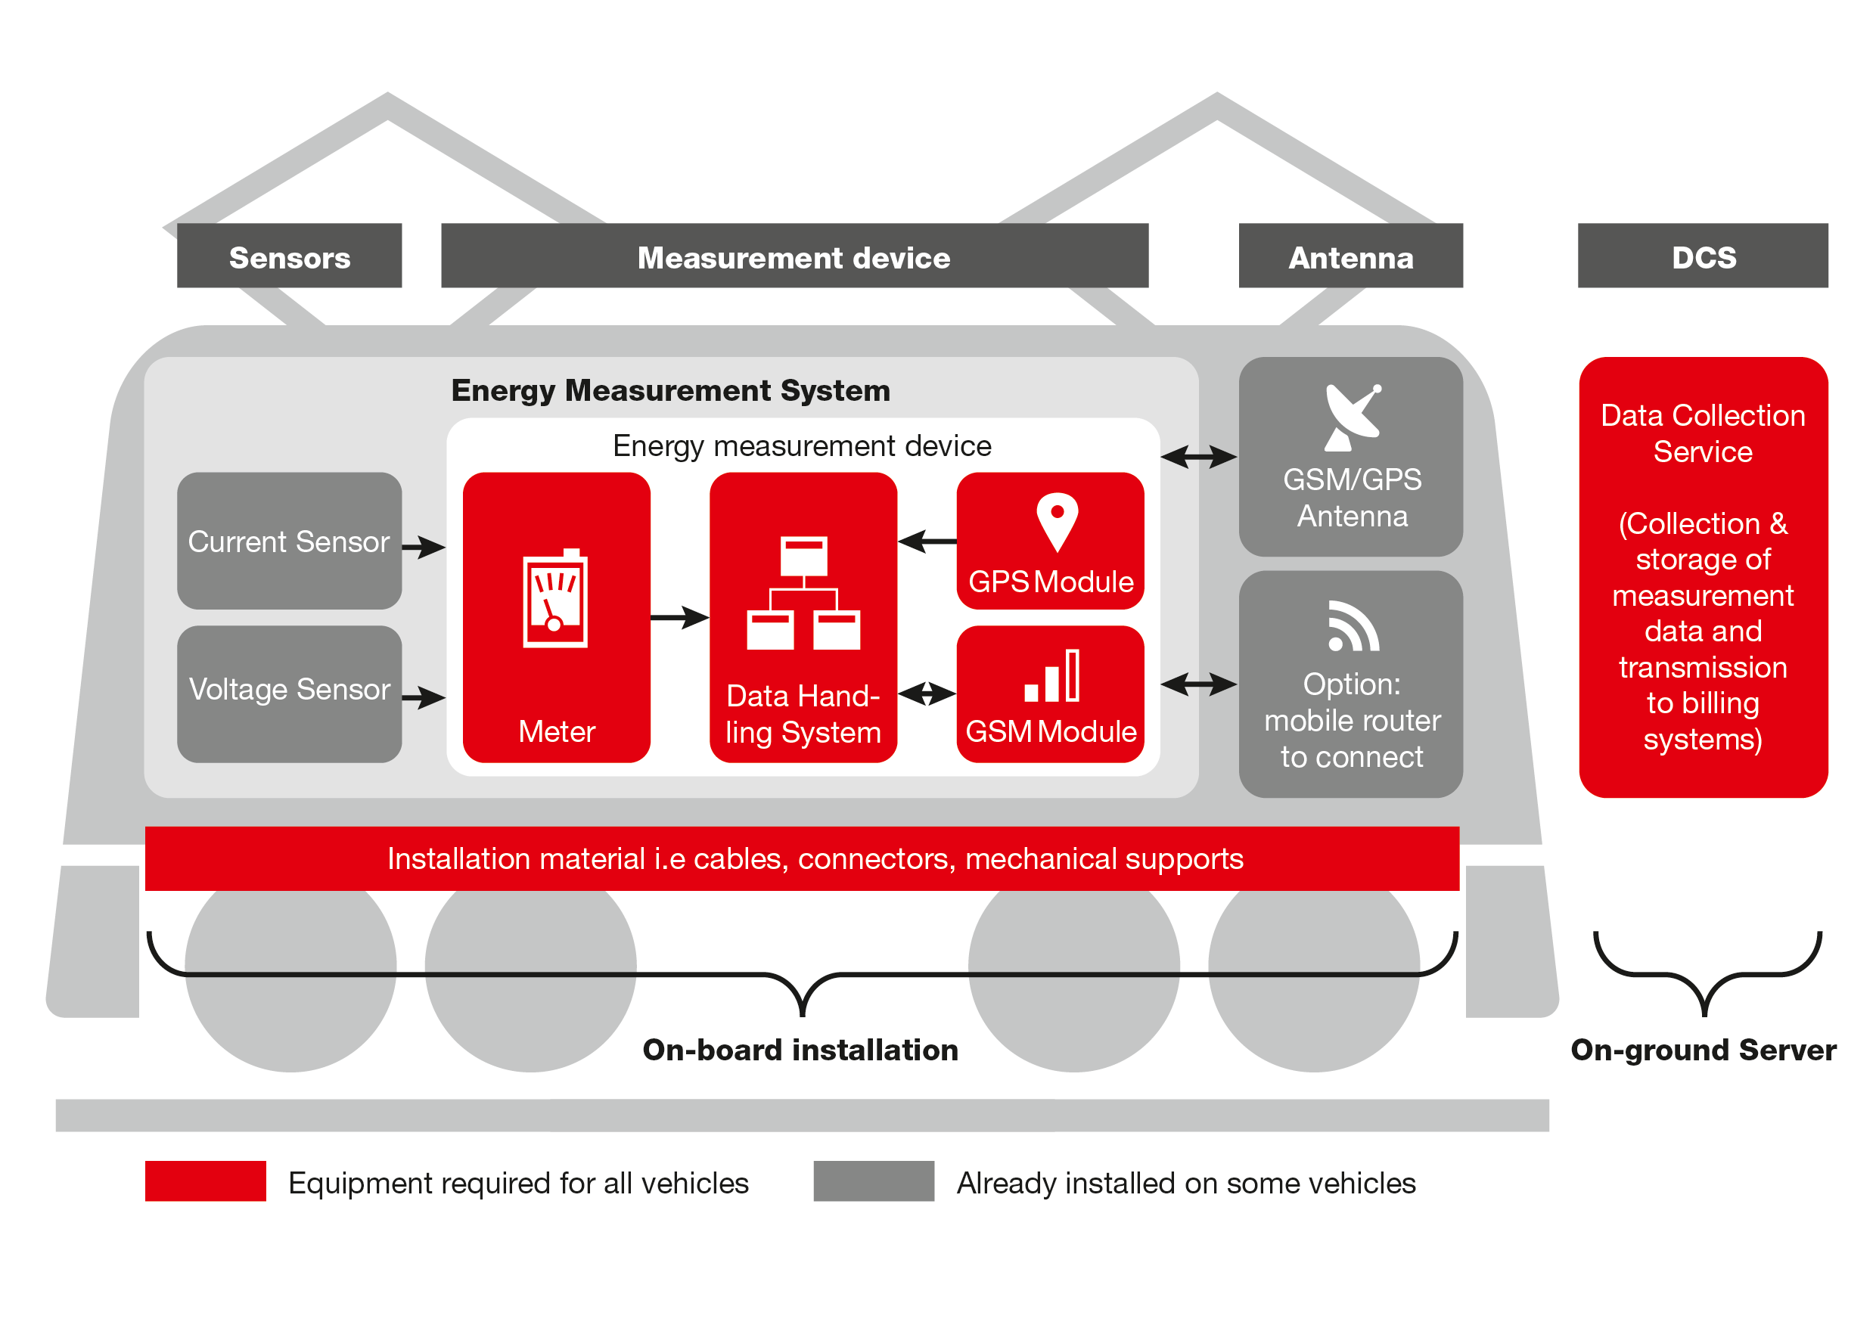
Energy Measurement System for railway vehicles
SBB • Infrastructure • Energie • 06-2019
3

Slide 4
Energy Measurement System for railway vehicles
Optimised EMS for each vehicle type (engine power <> sensor <> meter)
=> Fleet engineers need to undertand EMS design
Integration of EMS in the vehicle – it’s not just a meter-box
=> but also sensors, antennas, mobile routers, cabling, supports …
Hightech systems with complex software and sensitive electronics
=> plan specific training for installation and maintenance personal
Conformity Assessment is a good quality control for all EMS
=> needs to be done at vehicle level, not just component
Managing the data flow from DHS to billing system can involve several parties
=> role, responibilites and interfaces need to be clear
SBB • Infrastructure • Energie • 06-2019
4

