Slide 1
EN50463:2017 came into force October 2017. Since then customers specify their EMS project according to the 2017 standard.
Is your product today compliant with the 2017 EN50463 standard, including the use of new board to ground protocol?
It will be very soon! Starting from September 2019, all ECOSystem products will be compliant with EN50463:2017 standard, and the related NoBo certificates will be available by the end of the year.
If a customers chooses your product and want to use optional other services in a later stage (e.g. Request Reading Blocks, as mentioned in the EN50463:2017 part 4), do they have to specify the required services in the very beginning or is this easy adjustable through an update in later stage?
All software modules included in ECOSystem products can be easily updated according to new Customer requirements, including the ones arising from optional parts of the standard. When a DHS product is involved, a software update can also be managed over-the-air, without any train stop needed. Optional energy services are managed in the basic product release (e.g. readingblock). Some optional services will be managed in the basic product release (e.g AssetData). Subsequent implementations or requests may be applied.
The iCOM philosophy is to have a platform with basic functions, and any additional accessory modules that can be integrated into the platform.

Slide 2
<iCom Metering> a EMS scalable into a complete train digital platform
Energy Metering
Wheel, Axle, Bearings
Doors
HVAC
Pneumatic Brake System
Magnetic Track Brake
Electro Hydraulic Unit
Energy Metering
Windscreen Wiper
Sanding
Tap Changer
Battery Charger
Auxiliary Converter
ASU

Slide 3
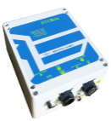
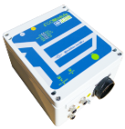
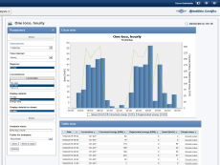
<ECOSystem> a modular Energy Metering system, adjustable to EN50463:2017 standard (certification to be completed within Nov. 2019)
 |  | Function | Input | Output | Output interface type | Features
ECOMeter |  | VMF CMF ECF | Catenary voltage and current | Current Voltage Energy | Optical fibre LAN | Single transducer for V and I, AC/DC
ECOBox |  | Interface | Current Voltage Energy | Elaborated signals | Customer specific interfaces, LAN | TCMS interface, SIL2 for functions such as catenary detection, overcurrent and harmonic monitoring
ECOCom |  | DHS | Instantaneous energy consumption | Energy data package to ground | WiFi, GMS, LAN | Communication gateway for any data
ECOModule |  | ECF DHS | LV signals for voltage and current | Energy data package to ground | WiFi, GMS, LAN | For use with train built-in sensors
ECOLogic |  | DCS | Energy Consumption and other train data | CEBD and fleet monitoring | According to EN50463 and customer interface | Capable of managing and elaborating any fleet data

Slide 4
As you know, EU member states shall have a DCS implemented by 1-1-2022. Also non-EMS suppliers might offer this product, maybe on non-profit terms (e.g. IM)
What would be the added value for a customer to choose your DCS?
ECOLogic is not merely a DCS. Advanced fleet monitoring can be performed via its fully-developed performances, including custom automatic alarms based on vehicle type, specific event (on a library of over 200 different events), consumed energy, position, speed, etc.
Its intuitive graphical user interface allows really simple but powerful operations, like multiple file retrievals, vehicles localization on real-time map, logfiles analysis and custom actions. Moreover, the system includes security features to monitor and control authorized access by users.
The Microelettrica ECOLogic platform has always given the possibility to have a product with contents higher than what is required by the standard.
iCOM integrates the possibility of performing data analysis (eg energy analysis, geographic, tabular and graphical visions, analysis on data grouping, daily and monthly data), event management, JOB and report, API for integration with SW 3rd parts .
Moreover iCOM being a platform with multiple functions allows to integrate different modules and centralize the use of multiple services (e.g. metering, driver analysis, backoffice for event monitoring, etc ...)

Slide 5
ECOLogic
<ECOLogic> a Fleet Monitoring and Managing System, DCS-based, with modular functions
Interface to iCOM-Assist, the Knorr Bremse driver assistant package
Customer fleet set up, managing, performance control
1second data
Fleet administration
Real time data collection, pre-analysis and forwarding to “big data” systems
Customer specific event settings and fully automated monitoring
DAS interface
Remote EMS
update
Remote EMS configuration, software update, vehicle testing
Customer fleet performance analysis and automatic monitoring
Fleet analysis
Event watcher
EREX interface
Billing system interface as per Customer request
GEO analysis
Energy data analysis based on time and position within all Europe
Data Collection System
Base functionality according to EN50463
ECOLogic-Energy data center and Fleet monitoring

Slide 6
According to the 2019 EMS survey, about 58% of participants responded to have energy meters installed on all trains by 2020. Which means there’s still something to gain in this market. But due to take-overs and other reasons, the number of EMS suppliers is decreasing
How will you distinguish your product and attract future customers to choose your product?
ECOSystem has several advantages. First of all it is modular and fully customizable, allowing the final customer the flexibility degree needed for the specific application. Moreover Microelettrica devices shew astounding reliability performances on field, being installed on thousands of vehicles. Finally, the products releases foreseen for Fall 2019 will be fully integrated into Knorr-Bremse iCOM platform, further evolving their integration with services considered nowadays essential by Customers, like CBM for example.
As for the DCS, iCOM will allow data sources from the second to the 5 minutes required by the standard.
The DHS will also be a platform that can be integrated on vehicles to allow metering but also different interfaces and services.
The integration between the DCS and the DHS Microelettrica will maximize the result between possible functionalities and services. For our platforms, we provide Saas services and ServiceDesk.

Slide 7
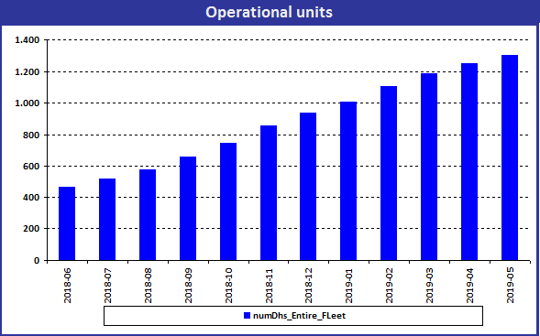
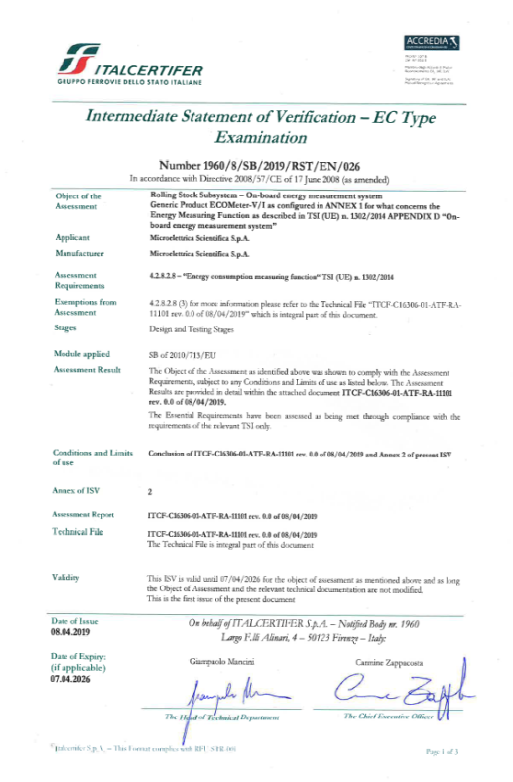
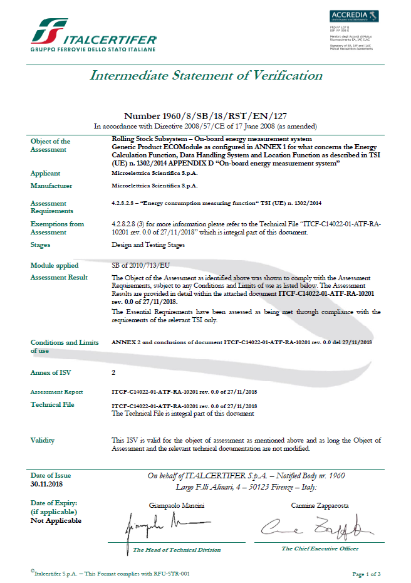
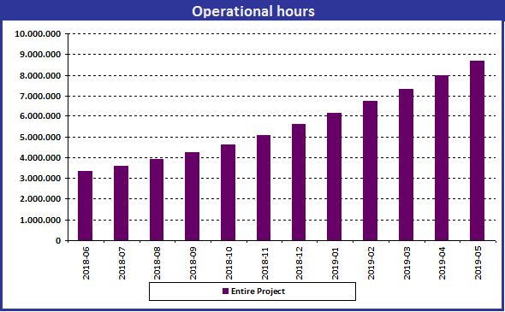
<ECOSystem strengths> references and certifications
References
Over 4000 systems installed
Single largest fleet with SBB/CFF/FFS (1300 pcs in service, 2000 pcs within end of 2019)
Certifications
TSI LOC & PAS
EN50463 (:2017 completed within 11/2019)
GM/RT2132

