Slide 1
UIC IRS 90930 Traction Energy Settlement and Data Exchange

Slide 2
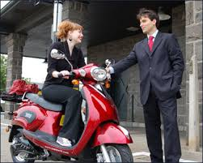
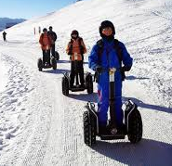
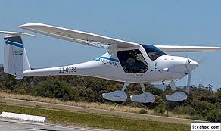
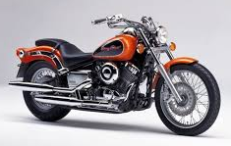
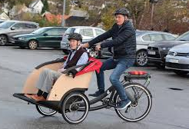
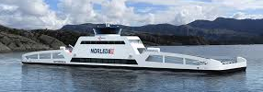
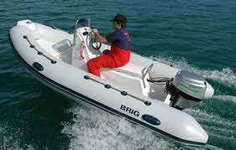
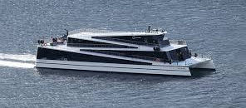
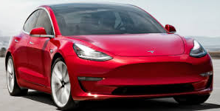
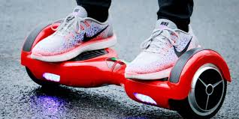
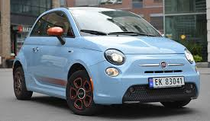
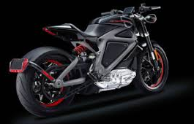
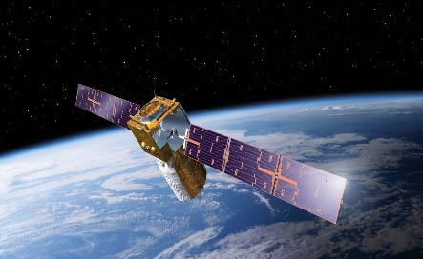
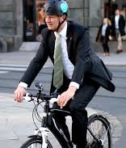
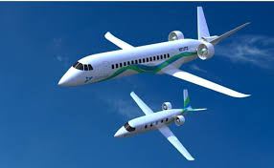
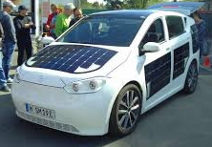
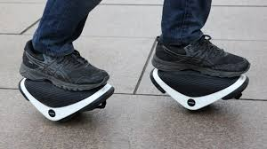
Electric traction development

Slide 3
IRS
Covers:
Best-Practice solutions
Roles interactions
Process interactions
Technical interactions
Does NOT cover:
Legal matters
Commercial contracts
Political discussions/statements

Slide 4
Scope
Define and specify a common framework and solutions wherever the know-how and best-practice in the market is mature enough.
The framework defines all relevant functions, roles and interactions, and specifies shared commercial and technical solutions, requirements and recommendations.
The scope is not to replace or overlap what is defined in relevant EU standards, TSIs or EU regulations.

Slide 5
Chapters
Foreword
Introduction
Scope
Normative References
Terms, Definitions and Abbreviations
Roles model and responsibilities of each Role
Functions
Data
Data Transfer
Processes
Appendixes
Similar to format in standards from other bodies.

Slide 6
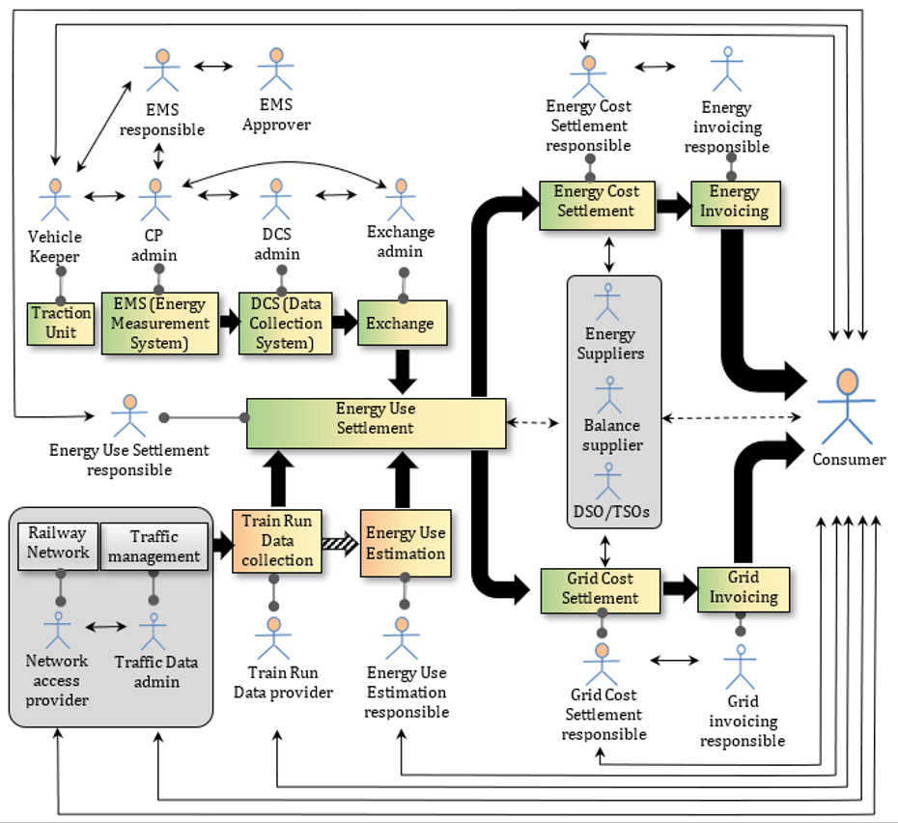
Role Model as a basis

Slide 7
Data
Metering data
Masterdata
Train Run data
Event Set & Heartbeat
Logs in functions
Readingblock possibilities
Settlement Area definitions

Slide 8
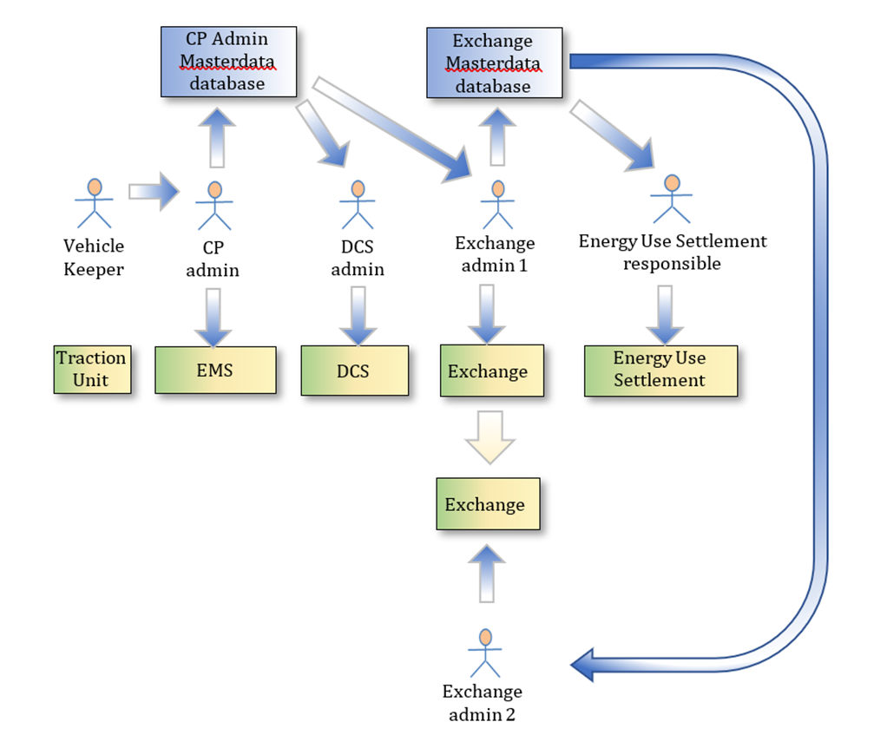
Masterdata
Roles has the responsibility, but it is envisaged that the dataflow will be automatic between the functions in the future
Company identification
Traction unit type specifications
Traction Unit list
EMS list
EMS installation test
EMS & TU type test declaration

Slide 9
Data transfers
Based on and refers to EN 50463:2017.
Migration to XML-based messaging format
Definition of messages
Application services to be used
Automatic data transfers and data requests
Data transfer deadlines

Slide 10
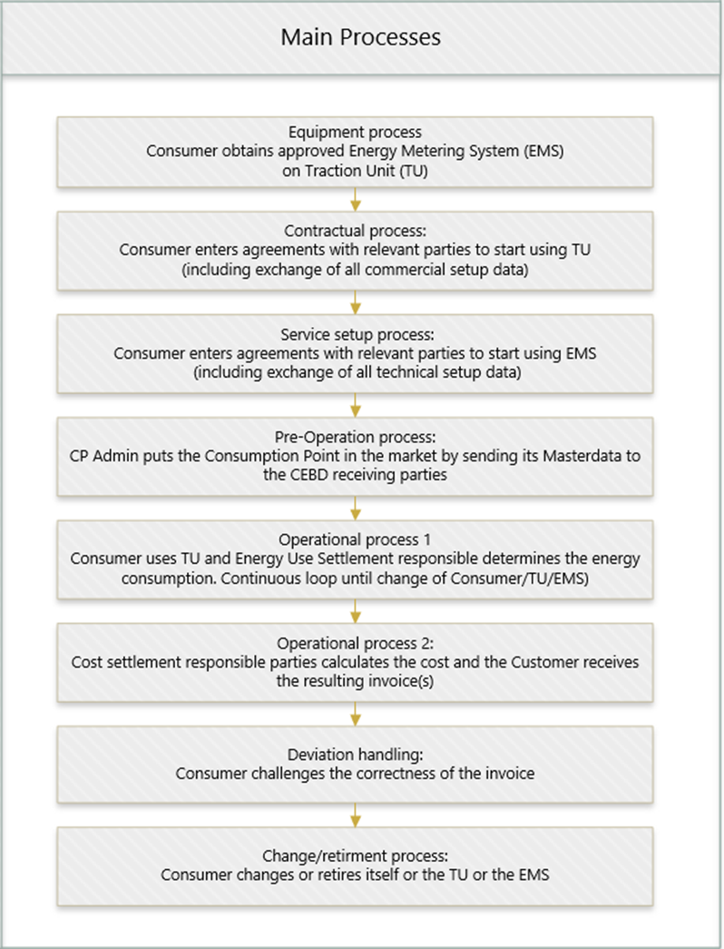
Processes

Slide 11
Open points
Who chooses:
EMS to be used
EMS to be accepted/cross-accepted
Conformity documentation format and content
Installation protocol/test format and content
CEBD to be sent or not
DCS to be used
Exchange to be used
Energy supplier ?
Approval/certification of services on ground?
who shall know all requirements of each settlement responsible (vehicle keeper, railway undertaking, .... ?)
availability/confidentiality for RU related data (masterdata, metering data, train run data, settlement data...?)

Slide 12
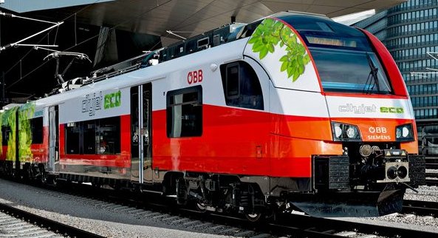
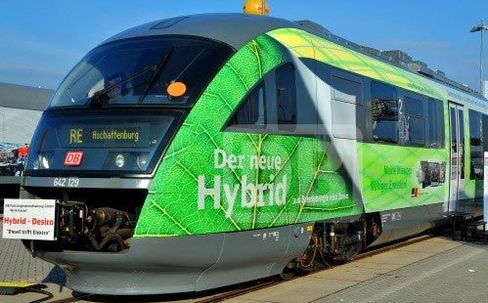
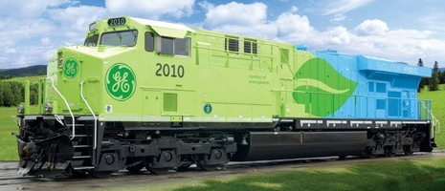
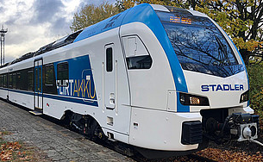
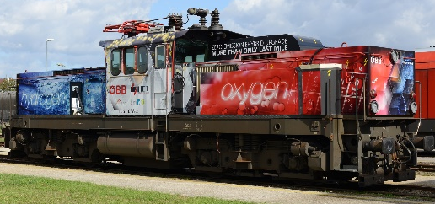
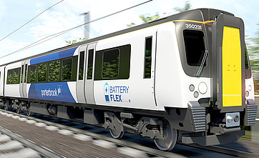
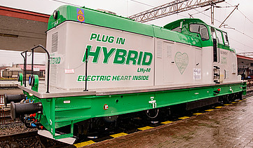
Open point: Hybrid Trains and Locos

Slide 13
Many directives, TSIs etc.
Directive (EU) 2009/72 of the European Commission regarding Energy Market Regulation,
Directive (EU) 2012/34 of the European Parliament and of the Council of 21 November 2012 establishing a single European railway area
Directive (EU) 2012/72 of the European Parliament and of the Council of 13 July 2009 concerning common rules for the internal market in electricity.
Regulation (EU) 2016/796 of the European Parliament and of the Council of 11 May 2016 on the European Union Agency for Railways
Directive (EU) 2016/797 of the European Parliament and of the Council of 11 May 2016 on the interoperability of the rail system within the European Union
Directive (EU) 2016/798 of the European Parliament and of the Council of 11 May 2016 on railway safety
Energy TSI: latest complete version published as annex of Commission Regulation (EU) No 1301/2014 of 18 November 2014 and amended via Commission Implementing Regulation (EU) 2018/868 of 13 June 2018
LOC & PAS TSI (locomotives and passenger rolling stock): latest complete version published as annex of Commission Regulation (EU) No 1302/2014 of 18 November 2014 and amended via Commission Implementing Regulation (EU) 2018/868 of 13 June 2018
OPE TSI (operation and traffic management): latest complete version published as annex of Commission Regulation (EU) No 995/2015 of 8 June 2015
TAP/TAF TSI (Telematic Applications for Passengers and Freight): consult webpages at ec.europa.eu and on www.era.europa.eu
EN 50463:2017 delivers the requirements for EMS, DCS and communication between EMS and DCS.
UIC Leaflet 930:2009 on data exchange for international traffic.

Slide 14
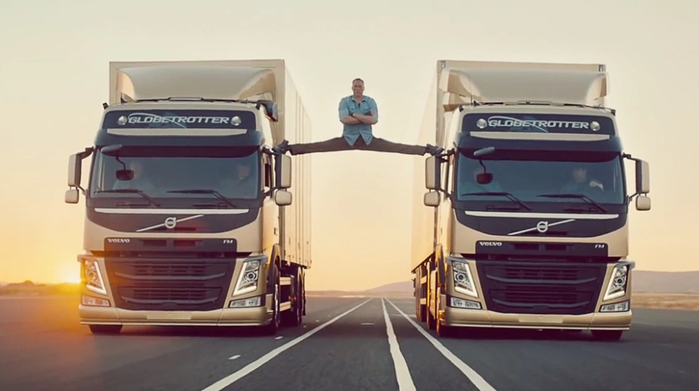
Standards and regulations
Market vs Regulation
Periodic not continuous upgrades
Strategic vs Operational topics
Benefit vs Cost
Experience vs theories
Need to have vs nice to have
Know-how vs wild ideas
Standardization work

Slide 15
Need: open discussion forums
Standards (and laws) is better produced when affected sector already has experience in the subject and are ready to choose a common way to do something.
Until sector has experience and are ready for standardization, the technical challenges and possibilities in and between systems and parties must be discussed outside standardization -projects and –organisations.
Sector still has a lot of questions and challenges before its operation and interoperability is 100% compliant and well functioning in Europe, and these are not suitable for being discussed in standardisation projects that have limited scope, deadlines and negotiations.

Slide 16
Proposal: 2 sector forums
Commercial open forum,
where periodically the actors freely can discuss any commercial problems and possibilities between parties and for the sector,
This will increase the knowledge sharing and commercial interaction between the parties, and will decrease the need for technical groups in standardisation bodies to discuss commercial issues that is often out of scope of their work.
EIM&CER is hereby challenged to set up and run such a forum as soon as possible.
Technical open forum,
where the actors periodically can discuss technical operational problems and possibilities in their interaction.
Based on the discussions in the IRS 90930 workgroup, this is needed to be set up independent of the standardization bodies (hereunder IEC, Cenelec or UIC) so that standardisation assignments to these bodies can be given on a better and clearer basis, scope and framework.
Eress is hereby proposing to set up and run such a forum as we have such discussions already running for 7 partner countries and 4 cooperating countries and is positive to expand this to such a forum.
THIS DOES NOT REPLACE THE ANNUAL ERESS FORUM ☺

