Slide 1
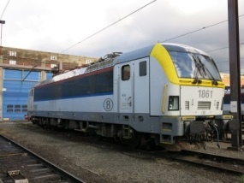
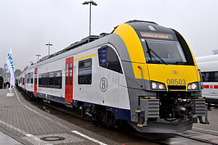
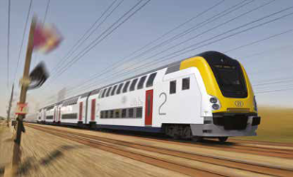
Traction fleet NMBS with energy meter on board
120 Locomotives type 18/19 (Siemens)
About 34% of actual train production (tkm of trains)
305 EMU’s type 08 (Siemens - Desiro)
About 20% of actual train production (tkm of trains)
80 coaches with traction type M7-BMx (Bombardier - Alstom)
About 15% of future train production (tkm of trains) (2021-2022

Slide 2
Traction fleet NMBS without energy meter
Other electrical locomotives type 13/21/27/28
About 12% of actual train production (tkm of trains)
Other EMU’s type 62-66,75,80,86,96
About 31% of actual train production (tkm of trains)
96 DMU’s
About 3% of actual train production (tkm of trains)

Slide 3
Month | Total all meters MWhplus | Total all meters MWhminus | Total with link to train nr. MWhplus | Total with link to train nr. MWhMinus | approximative percentage of meter without link to train number
1901 | 5835 | 283 | 2657 | 144 | 49%
1902 | 5812 | 377 | 2153 | 149 | 60%
1903 | 6768 | 444 | 1975 | 142 | 68%
1904 | 7872 | 534 | 3664 | 275 | 49%
1905 | 8209 | 584 | 4640 | 360 | 38%

Slide 4
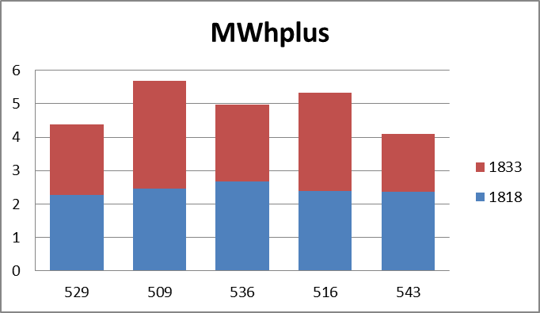
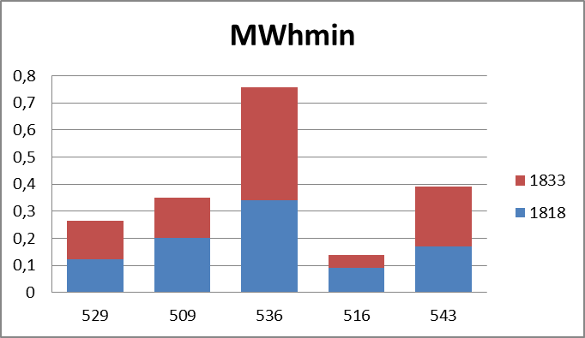
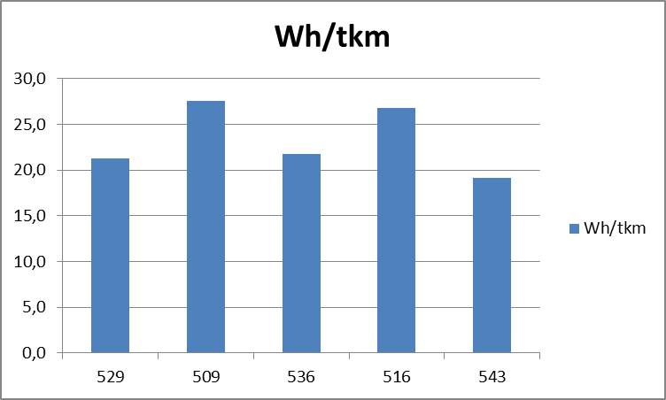
train composition (locT18 – 12 coaches – locT18) IC 1: Oostende-Eupen

Slide 5
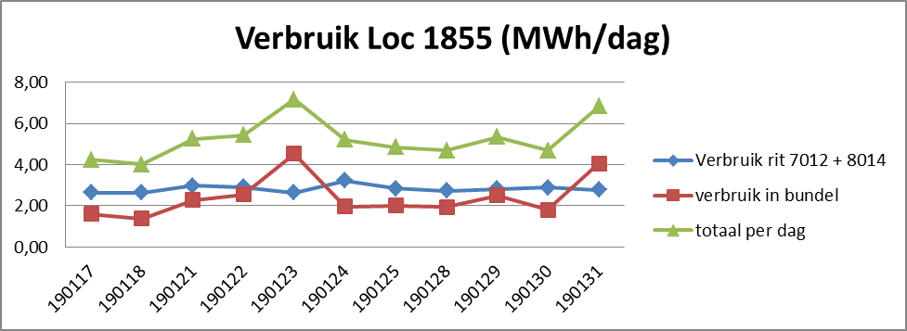
Case loc 1855 van 17 tot 31 januari 2019.
Morning train 7012: Gent-Aalst-Schaarbeek groep R (1 HLE19+11 HV M4)
Evening train 8014: Schaarbeek groep R- Aalst-Gent (1 HLE19+11 HV M4)

Slide 6
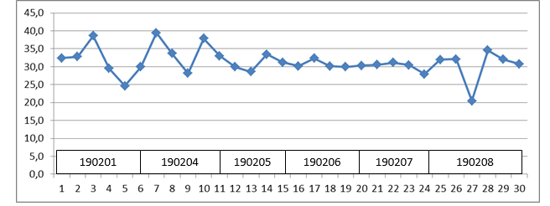
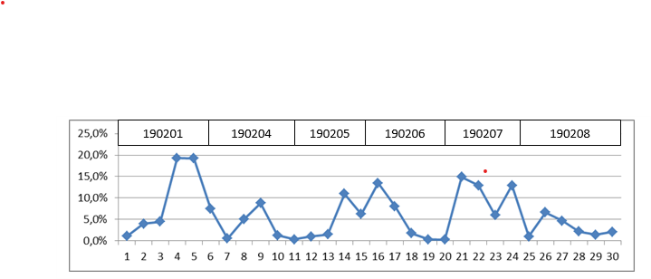
Specific consumption same loc, different routes. (Wh/tkm)
Recuperation ratio

Slide 7
Comparison train 2528 and 2536

Slide 8
EMU 08005 – 17 days in May 2019
Total train km | 6.203 | km
Total amount of hours used in train composition | 167 h | 41%
total amount of hours in siding with panto up | 142 h | 35%
Total consumption | 33,5 | MWh
Total consumption in train composition | 26,5 | MWh
% recuperation when running | 37%
% recuperation total consumption | 31%
Total consumption in “parking mode” | 7,0 | MWh
% of total consumption in “parking mode” | 21%
mass | 153 | ton
tkm | 949.059 | tkm
Wh/tkm when running | 27,9 | Wh/tkm
Wh/tkm total | 35,3 | Wh/tkm

Slide 9
local train Leuven – Brussel - Braine-le-Comte,
62 km, 22 stops
E3681 en E3761 (macho style)
Strong acceleration
to max speed
Max deceleration
To early
E3681 (L-Blc)
consumption: 747 kWh
Recuperation: 273 kWh
Net consumption: 474 kWh
E3761 (Blc-L)
consumption: 739 kWh
Recuperation: 319 kWh
Net consumption: 420 kWh
E3784 en E3664 (eco driving style)
gradual acceleration to 100%
Until advisory speed
Gradual deceleration
On time
E3784 (L-Blc)
consumption: 472 kWh
Recuperation: 205 kWh
Net consumption: 267 kW
E3664 (Blc-L)
consumption: 429 kWh
Recuperation: 218 kWh
Net consumption: 211 kWh

